Slide 1


ROP and CFI
SE3331-1 (2025 Fall)
IPADS, Shanghai Jiao Tong University
https://www.sjtu.edu.cn
Notes:
Credits to Mike Freedman (COS 461) and others.

Slide 2
Review: Goals of Security
Information security goals:
  Confidentiality: limit who can read data
  Integrity: limit who can write data
Liveness goals:
  Availability: ensure service keeps operating

Slide 3
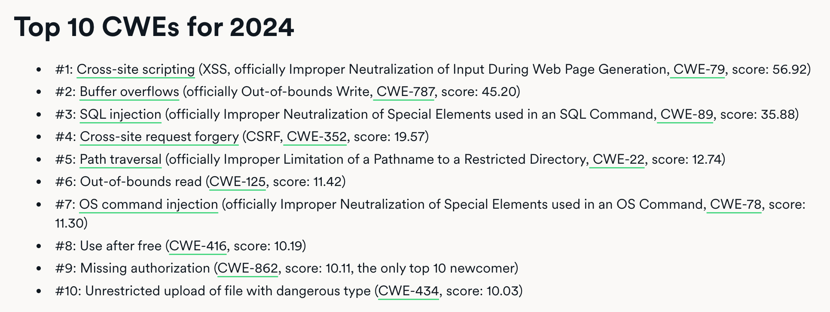
Review: Top Attacks

Slide 4
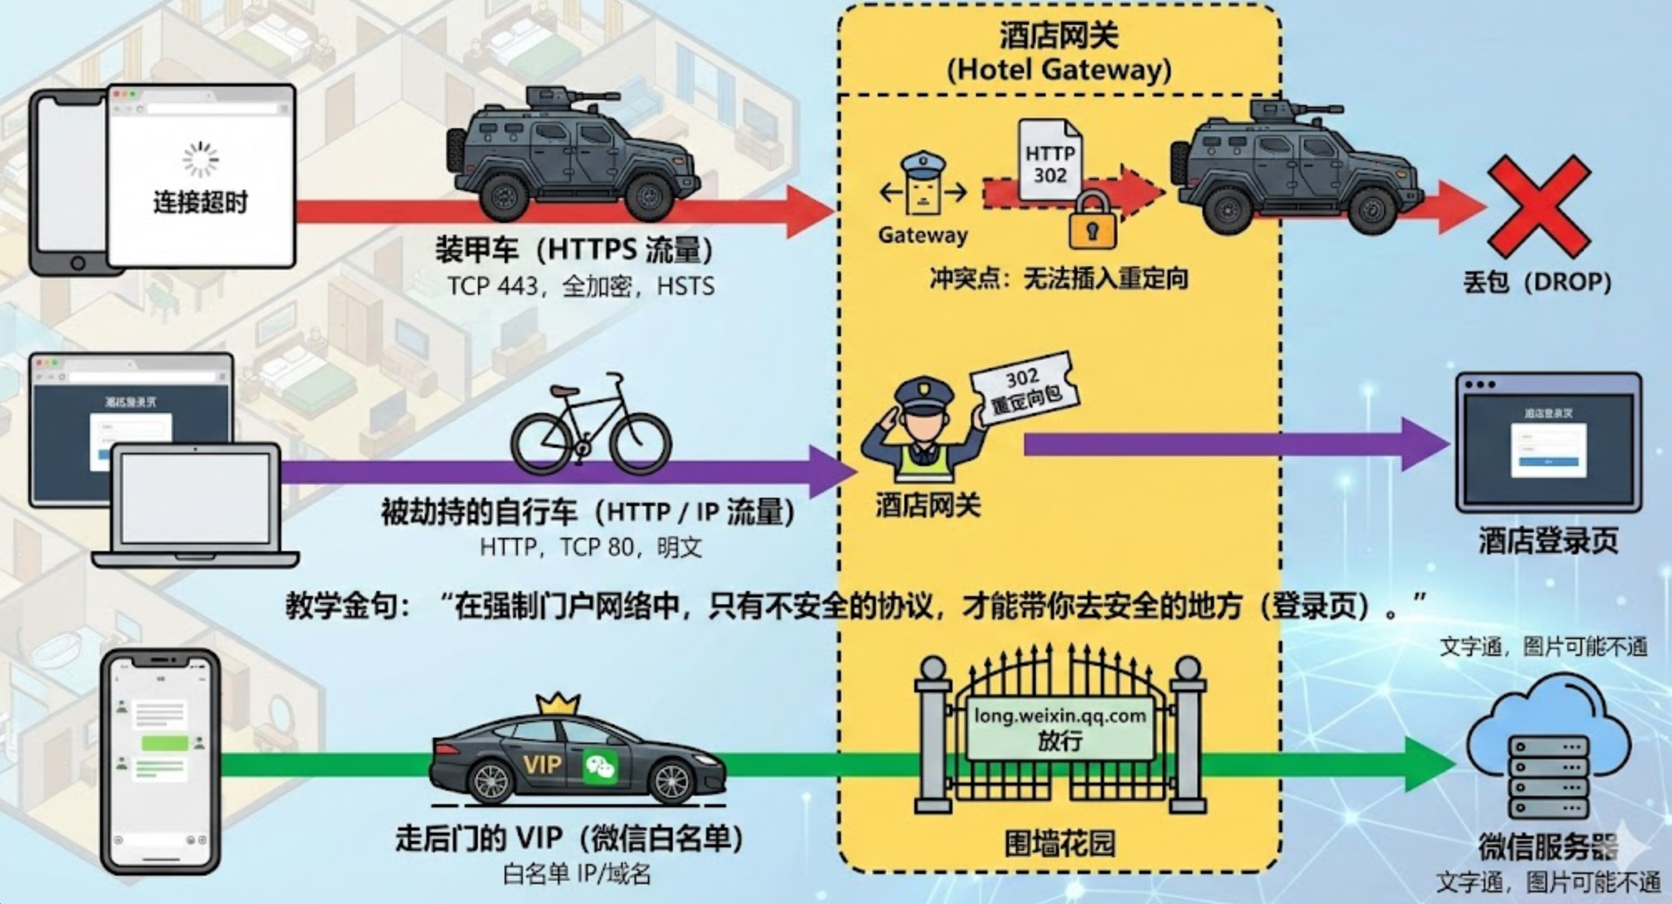

Slide 5
Security Principles

Slide 6
Principle of Least Privilege
Deal with bugs / incomplete mediation
  Any component that can arbitrarily access a resource must invoke the guard
  If component has a bug or design mistake, can lead to incomplete mediation
  General plan: reduce the number of components that must invoke the guard
    E.g., arrange for DB server to check permissions on records returned, then security does not depend as much on lookup.cgi

Slide 7
Least Trust
Privileged components are "trusted"
  Trusted is “bad”: you are in trouble if a trusted component breaks
  Untrusted components are “good”: does not matter if they break
  Good design has few trusted components, other things do not affect security

Slide 8
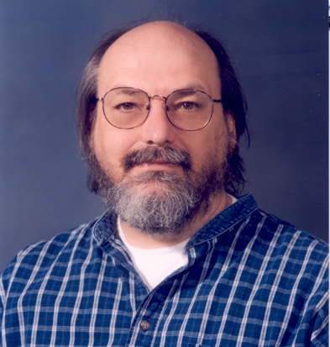

Ken Thompson: Reflections on Trusting Trust
source-code of bugged compiler
source-code of innocent compiler
source-code of /bin/login program
compiler
bugged compiler
bugged compiler

Slide 9

"The moral is obvious. You can't trust code that you did not totally create yourself. (Especially code from companies that employ people like me.)"
Ken Thompson used to work as a distinguished engineer for Google

Slide 10
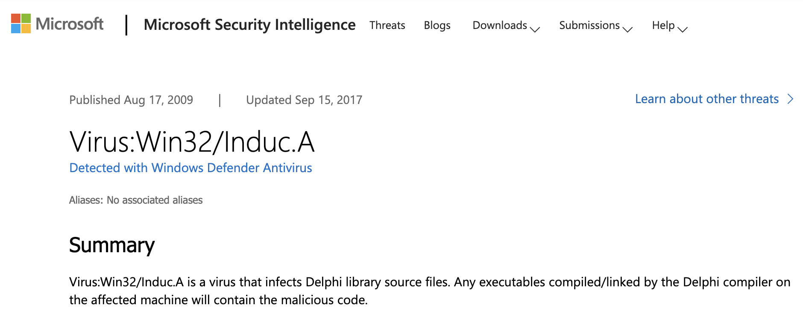
Any executables compiled/linked by the Delphi compiler
on the affected machine will contain the malicious code.

Slide 11
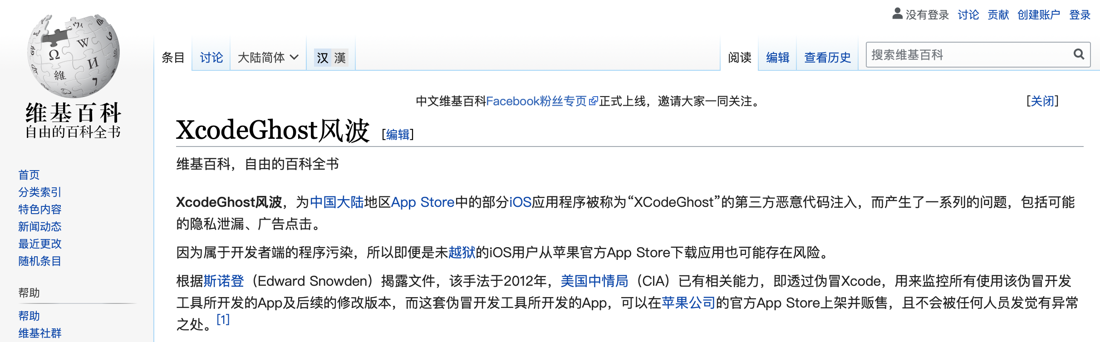
"No amount of source-level verification or scrutiny will protect you from using untrusted code."

Slide 12
Users Make Mistakes
Social engineering, phishing attacks
  How many of you really read the permission acquired by apps during installing?
Good idea: threat model should not assume users are perfect

Slide 13
Cost of Security
Security VS. Availability
  E.g., system requires frequent password changes -> users may write them down
How far should a teacher go to protect the exam file?
  Put the file on a separate computer, to avoid sharing a file system?
  Disconnect computer from the network, to avoid remotely exploitable OS bugs?
  Put the server into a separate machine room?
  Get a guard to physically protect the machine room?
  ...
Good idea: cost of security mechanism should be commensurate with value
Notes:
Most security goals/policies not infinitely valuable, can tolerate attacks.
Security mechanisms can be expensive (e.g., wasted user time).

Slide 15
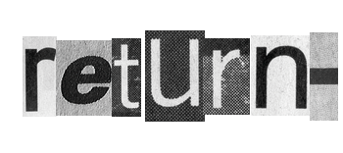


Slide 16
Review: Stack Buffer Overflow
A Typical Buffer Overflow Attack
  Inject malicious code in buffer
    E.g., shellcode
  Overwrite return address to buffer
  Once return, the malicious code runs
0101011010111010111010
return addr
ebp
saved ebp
01101101010101010101011010101010101011101010
void function(char *str) {
char buf[16];
strcpy(buf,str);
}
buf

Slide 17
Shellcode Sample to Open "/bin/sh" (21 bytes)
int main(){
char sc[] = "\x6a\x0b" // push byte 0xb
"\x58" // pop eax (now eax=0xb)
"\x99" // cdq
"\x52" // push edx (now edx=0)
"\x68\x2f\x2f\x73\x68" // push dword 0x68732f2f
"\x68\x2f\x62\x69\x6e" // push dword 0x6e69622f
"\x89\xe3" // mov ebx, esp
"\x31\xc9" // xor ecx, ecx (now ecx=0)
"\xcd\x80"; // int 0x80
((void (*)()) sc)();
}
More can be found on https://www.exploit-db.com
Notes:
Convert Double to Quad的缩写，意为将双字数据扩展为四字。 该指令先把edx的每一位置成eax的最高位（若eax>=0x80000000, 则edx=0xFFFFFFFF；若eax<0x80000000，则edx=0x00000000） ，再把edx扩展为eax的高位。
68: h
73: s
2f: /
2f: /
6e: n
69: i
62: b
2f: /

Slide 18
Defense: DEP (Data Execution Prevention)
Execute Code, not Data
Data areas marked non-executable
  Stack marked non-executable
  Heap marked non-executable
Enforced by hardware
  NX: Non-eXecutable (the name on hardware)
You can load your shellcode in the stack or the heap…but you can't jump to it to execute

Slide 19
Attack: Code Reuse (instead of inject) Attack
ROP: Return-oriented Programming
  Find code gadgets in existed code base
    Usually 1-3 instructions, ends with 'ret'
    In libc and application, intended and unintended
  Push address of gadgets on the stack
  Leverage 'ret' at the end of gadget to
  connect each code gadgets
  No code injection
0101011010
0101011010
0101011010
return addr
0101011010
saved ebp
0101011010
0101011010
0101011010

Slide 20
Code Execution – The ROP Way
Mem[v2] = v1
a₃
v₂
a₂
v₁
Desired Logic
Stack
mov %eax v1;
mov %ebx v2;
mov [%ebx], %eax
a₁: pop eax; ret
a₂: pop ebx; ret
a₃: mov [ebx], eax

Slide 21
Code Execution – The ROP Way
a₃
v₂
a₂
v₁
a₁
…
argv
argc
return addr
caller's ebp
buf (64 bytes)
argv[1]
buf
Mem[v2] = v1
Desired Shellcode
%ebp
a₁: pop eax; ret
a₂: pop ebx; ret
a₃: mov [ebx], eax
Desired store executed!
%esp

Slide 22
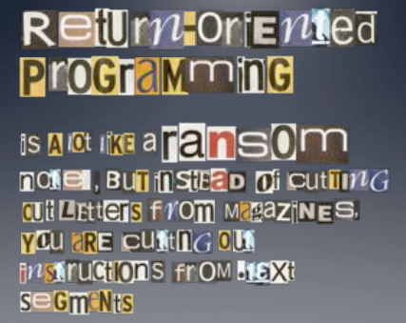

Slide 23
Defense
Hide the binary file
  No way to get any gadget
ASLR to randomize the code position
  Short for "Address Space Layout Randomization"
  Harder to find gadgets
Canary to protect the stack
  Try to detect stack overflow (e.g., overflow return address)

Slide 24
ASLR
Change the layout of memory space
Every time when a process is created
  Question: how about create by fork?
User-level as well as kernel-level

Slide 25

Canary
Embed "canaries" in stack frames and verify their integrity prior to function return
  Canary is just a random number
  Check canary before return, alert if not equal
StackGuard implemented as a GCC patch
  Program must be recompiled
  Performance overhead: 8% for Apache
Stack
Return Addr
Canary

Slide 26
CFI: Control Flow Integrity

Slide 27
CFI: Control-Flow Integrity
Main idea: pre-determine control flow graph (CFG) of an application
  Static analysis of source code
  Static binary analysis ← CFI
  Execution profiling
  Explicit specification of security policy
Execution must follow the pre-determined control flow graph

Slide 28


CFI Motivation
Control flow
Anatomy of many software attacks
Notes:
Many software attacks consists in subverting the control-flow of a binary. Often the virus injects code of its own,. Then by a buffer overflow, it hijacks the program counter to execute the desired code, eventually reaching a point at which the system is compromised (e.g., a shell is executed).

Slide 29
CFI Idea
+
=
Executable
Control-Flow Graph
Self-checking program
Notes:
The idea of CFI is very simple: embed a simple security policy within the executable itself, in the form of a control-flow graph. The executable itself will monitor its execution, and any attempt to deviate from the prescribed CFG will result in an error. Thus, if a virus attempts to step outside the prescribed CFG, it will shut down the program.

Slide 30
Branch Types
Direct Branches
  Direct call
  Direct jump
Indirect Branches
  Return
  Indirect call
  Indirect jump
In Apache and its libraries
Types | In Binary | Run-time
Direct call | 16.8% | 14.5%
Direct jump | 74.3% | 0.8%
Return | 6.3% | 16.3%
Indirect call | 2.1% | 0.2%
Indirect jump | 0.5% | 68.3%
has 1 target: 94.7%
<= 2 targets: 99.3%
>10 targets: 0.1%

Slide 31
CFI: Binary Instrumentation
Use binary rewriting to instrument code with runtime checks
Inserted checks ensure that the execution always stays within the statically determined CFG
Whenever an instruction transfers control, destination must be valid according to the CFG
Goal: Secure even if the attacker has complete control over the thread's address space

Slide 32
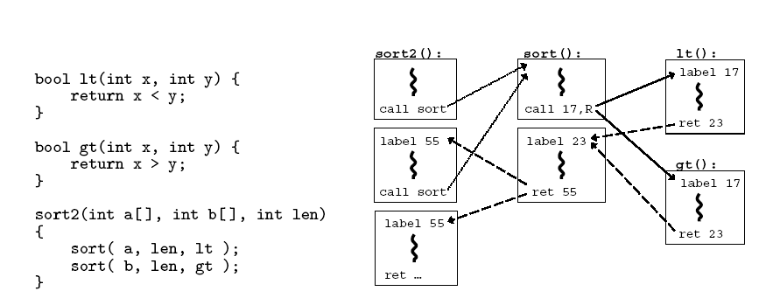
CFG Example

Slide 33
CFI: Control Flow Enforcement
For each control transfer, determine statically its possible destination(s)
Insert a unique bit pattern at every destination
  Two destinations are equivalent if CFG contains edges to each from the same source
    This is imprecise (why?)
  Use same bit pattern for equivalent destinations

Slide 34
CFI: Control Flow Enforcement
Insert binary code that at runtime will check whether the bit pattern of the target instruction matches the pattern of possible destinations

Slide 35
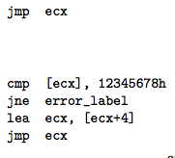
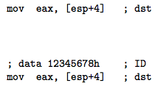
CFI: Example of Instrumentation
Original
Patched

Slide 36
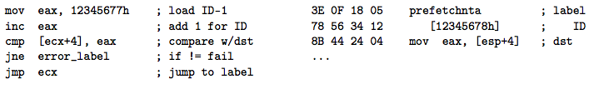
CFI: Example of Instrumentation
Prefetchnta: prefetch memory to cache. Become a nop if not available.

Slide 37
CFI: Preventing Circumvention
Unique IDs
  Bit patterns chosen as destination IDs must not appear anywhere else in the code memory except ID checks
Non-writable code
  Program should not modify code memory at runtime
    What about run-time code generation and self-modification?
Non-executable data
  Program should not execute data as if it were code
Enforcement: hardware support + prohibit system calls that change protection state + verification at load-time

Slide 38
Improving CFI Precision
Suppose a call from A goes to C, and a call from B goes to either C, or D (when can this happen?)
  CFI will use the same tag for C and D, but this allows an "invalid" call from A to D
  Possible solution: duplicate code or inline
  Possible solution: multiple tags

Slide 39
Improving CFI Precision
Function F is called first from A, then from B; what's a valid destination for its return?
  CFI will use the same tag for both call sites, but this allows F to return to B after being called from A
  Solution: shadow call stack
    Maintain another stack, just for return address
    Intel CET to the rescue (not available yet)

Slide 40
CFI: Security Guarantees
Effective against attacks based on illegitimate control-flow transfer
  Stack-based buffer overflow, return-to-libc exploits, pointer subterfuge
Does not protect against attacks that do not violate the program's original CFG
  Incorrect arguments to system calls
  Substitution of file names
  Other data-only attacks

Slide 41
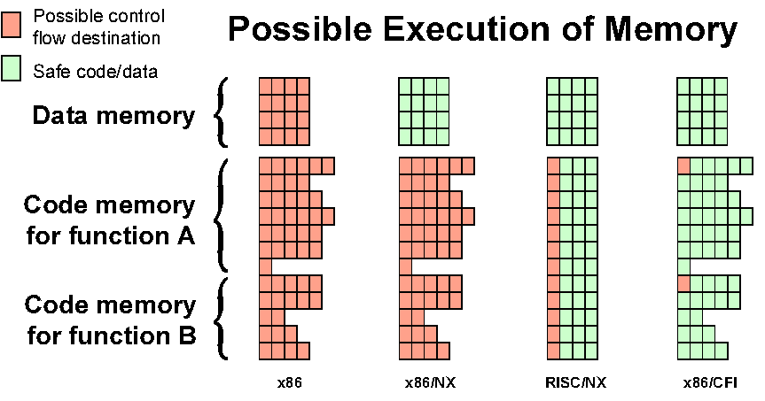
Possible Execution of Memory
[Erlingsson]

Slide 42
Blind ROP

Slide 43
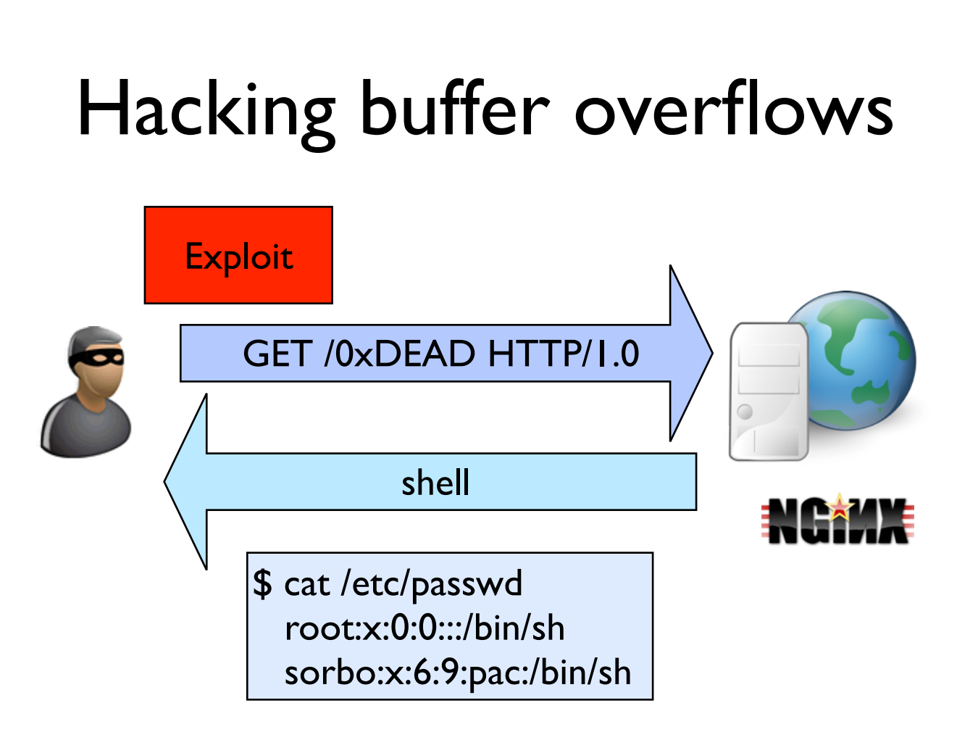

Slide 44
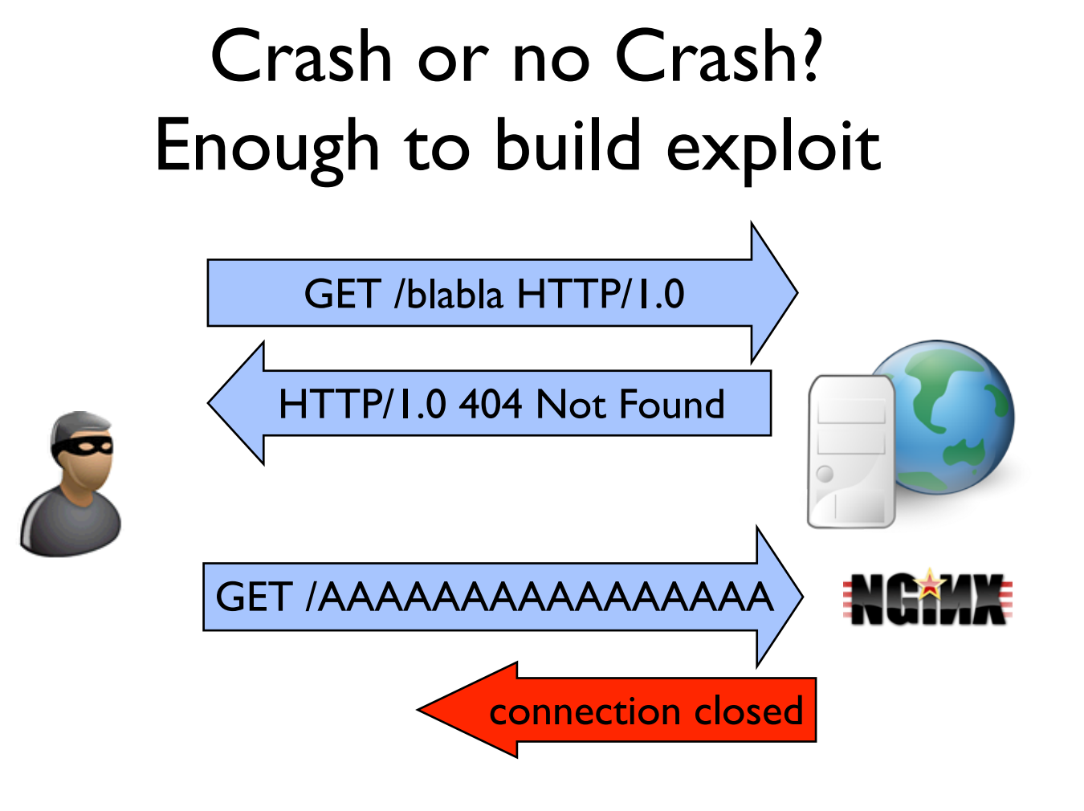

Slide 45
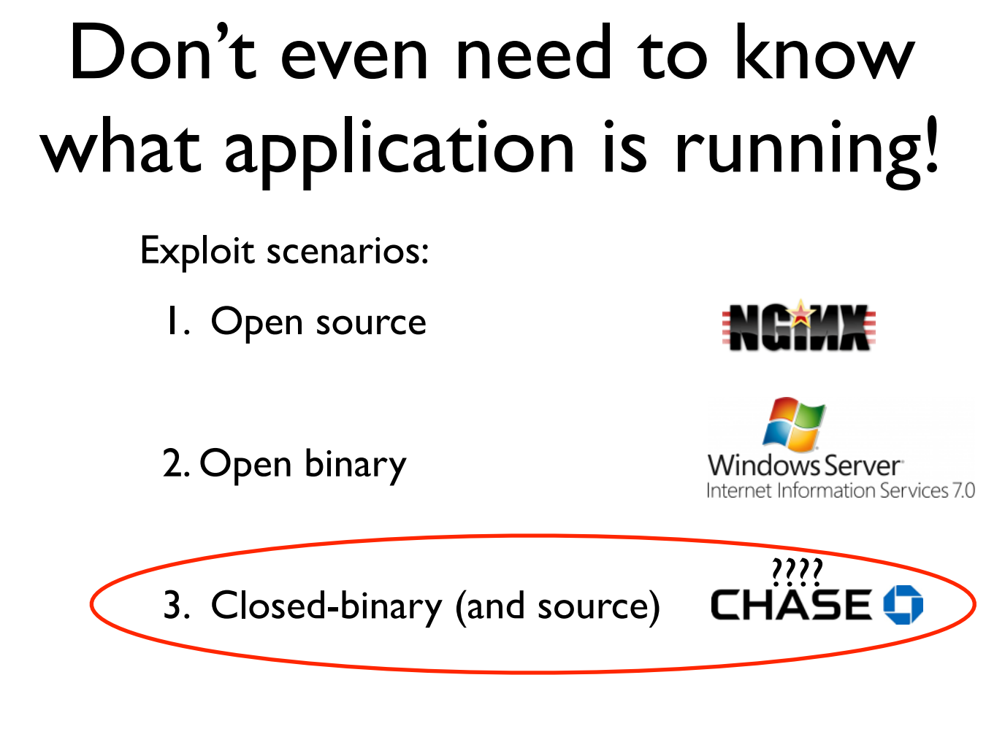

Slide 46
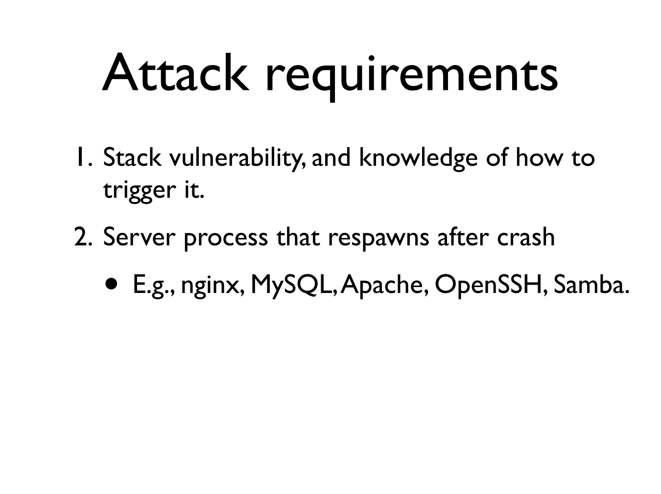

Slide 47
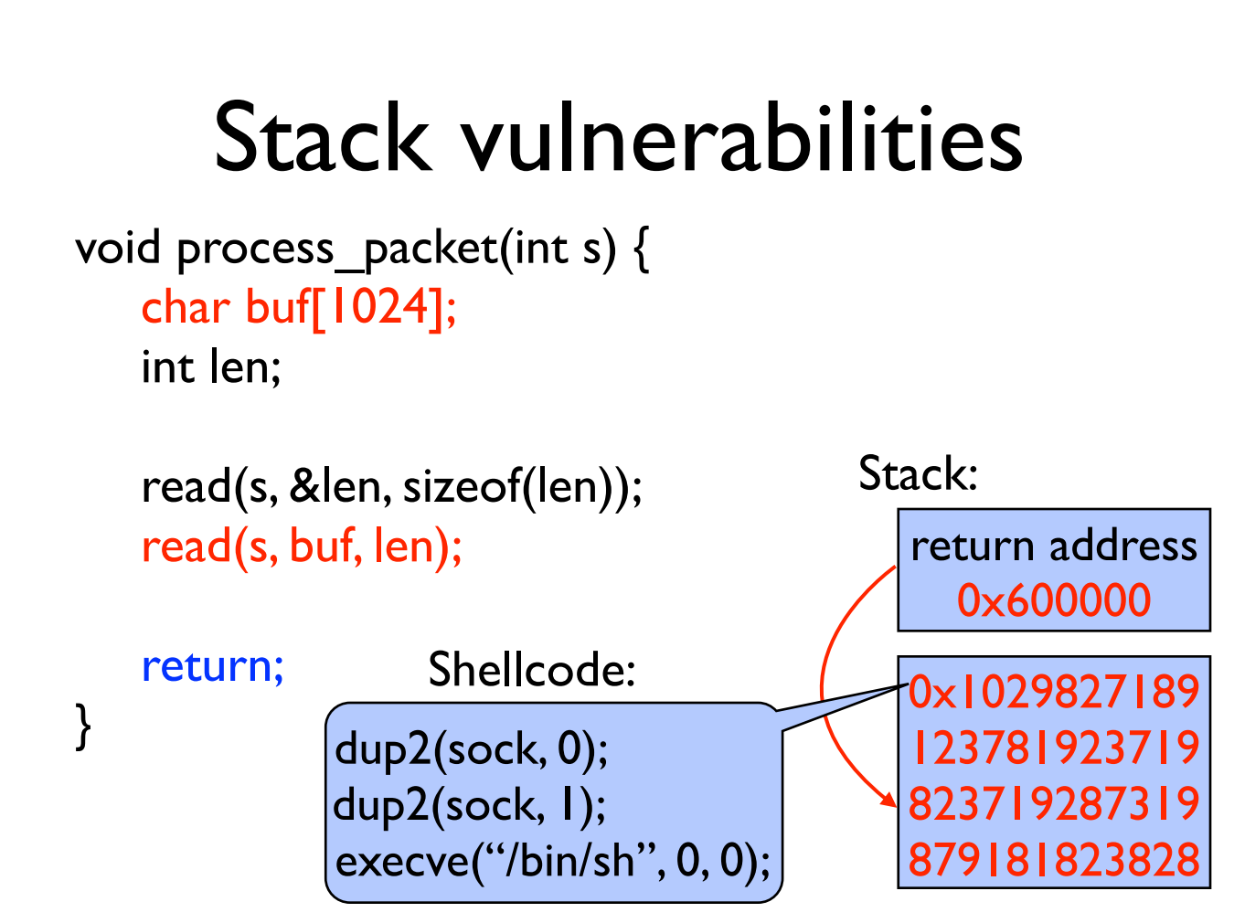

Slide 48
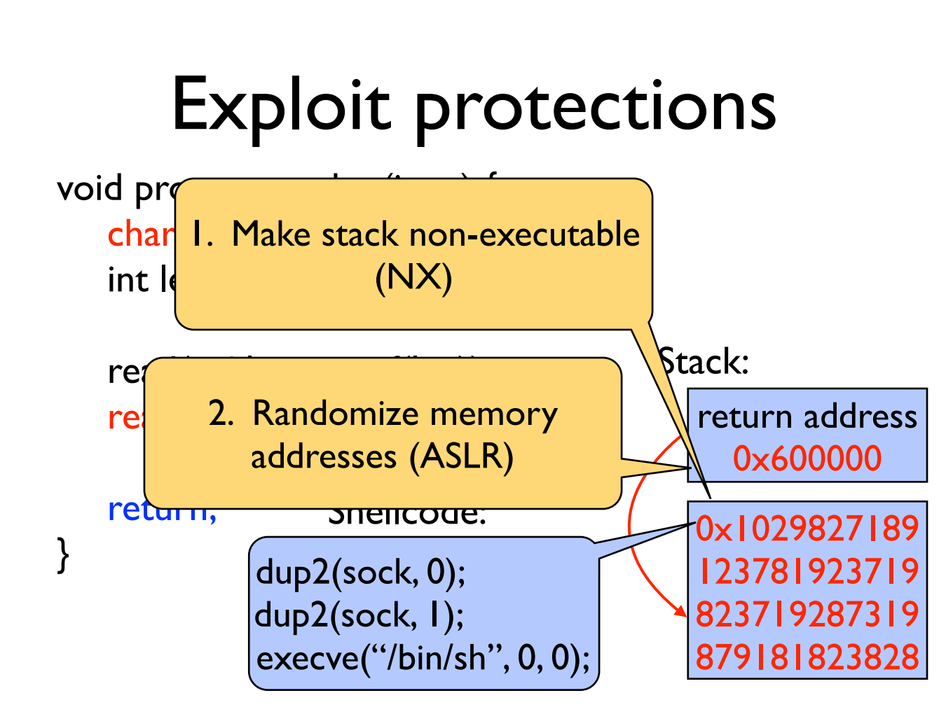

Slide 49
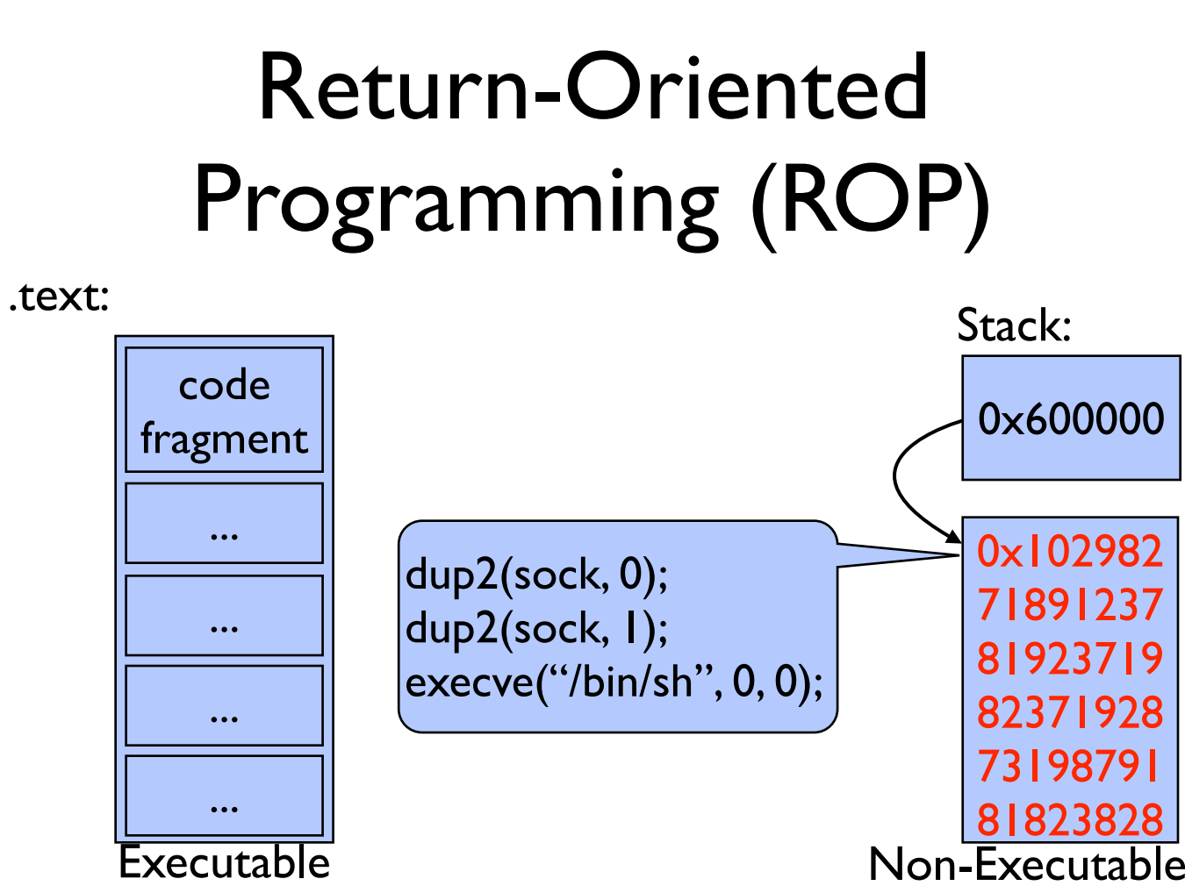

Slide 50
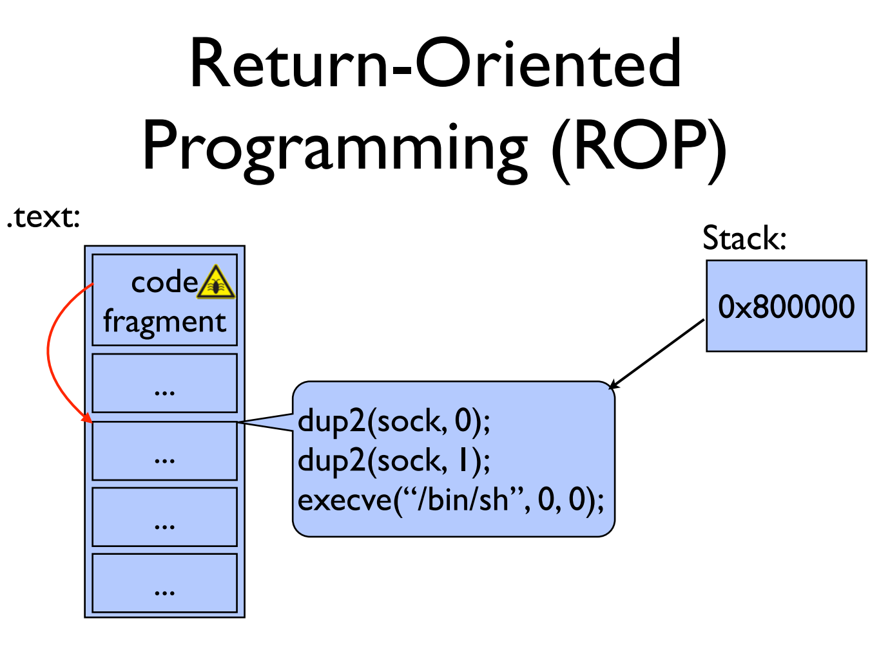

Slide 51
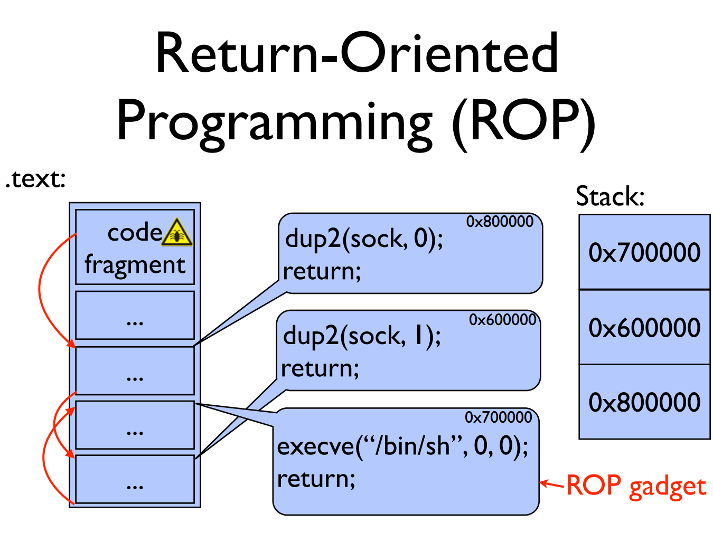

Slide 52
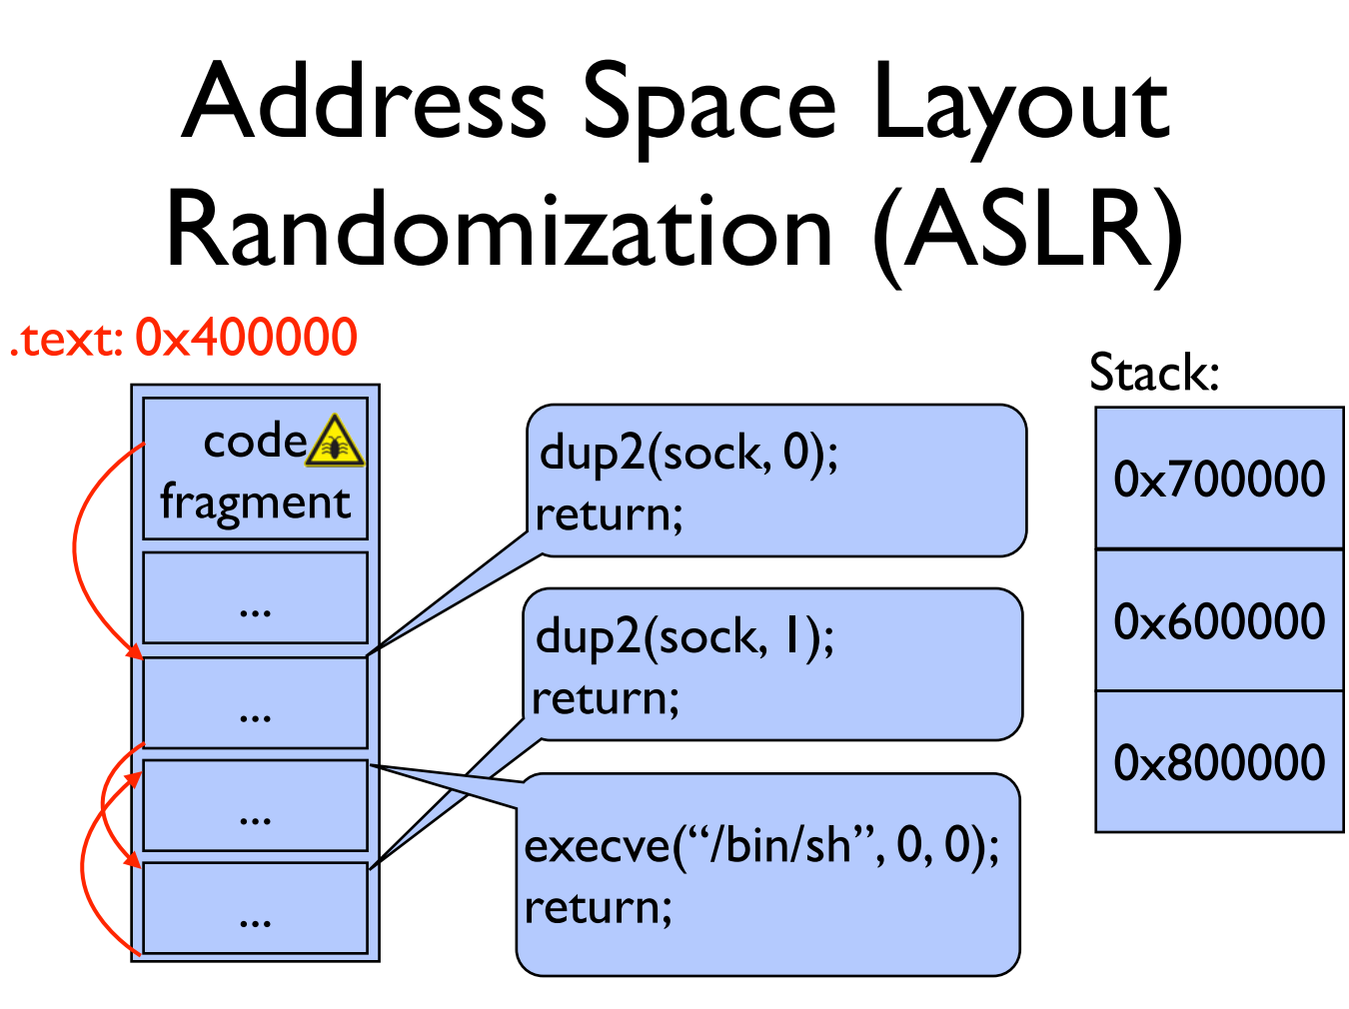

Slide 53
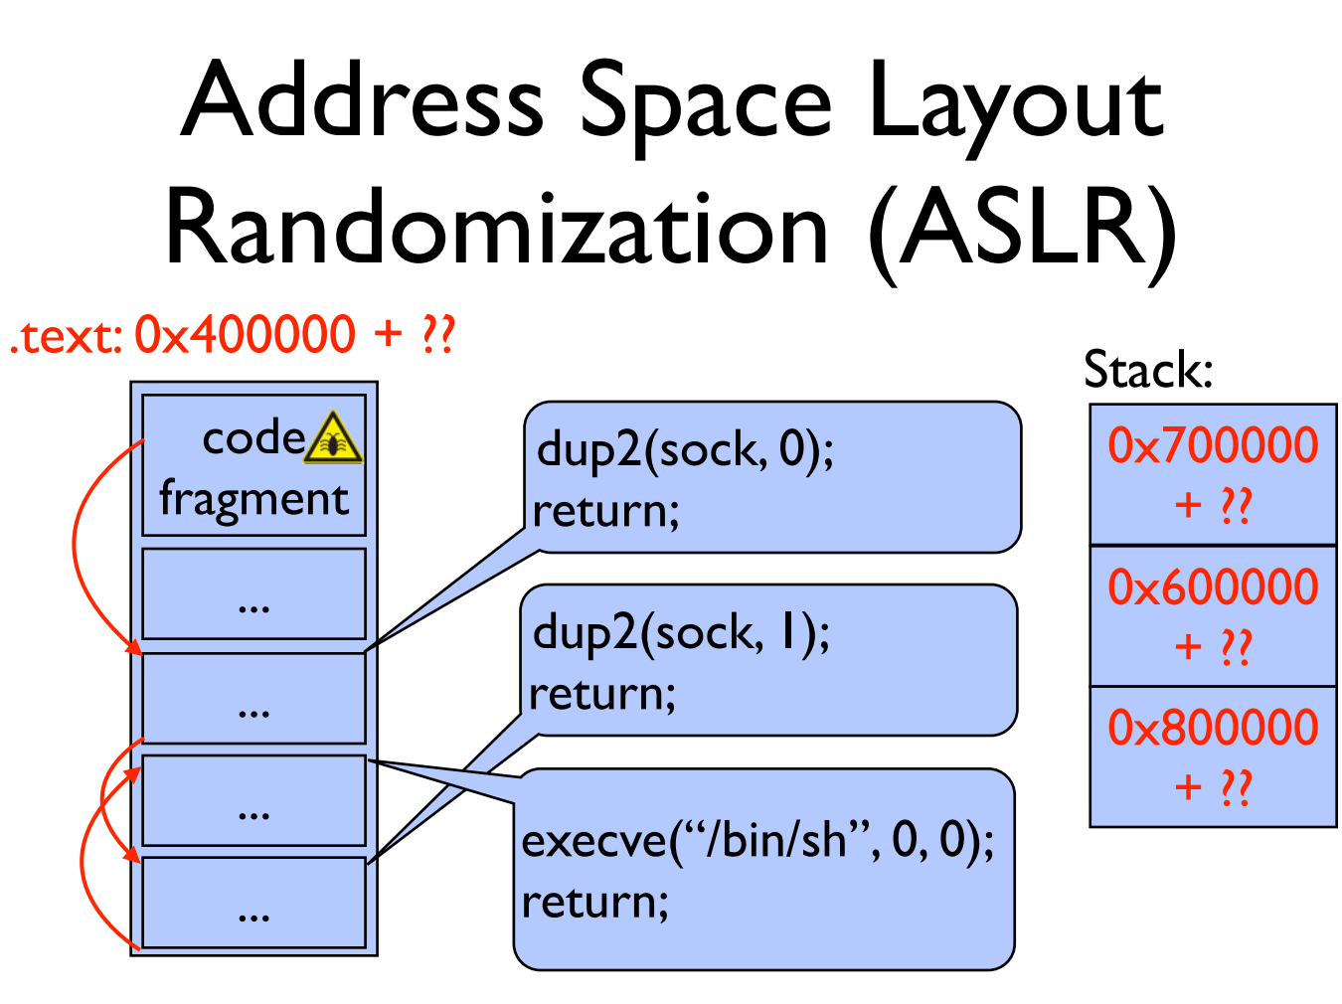

Slide 54
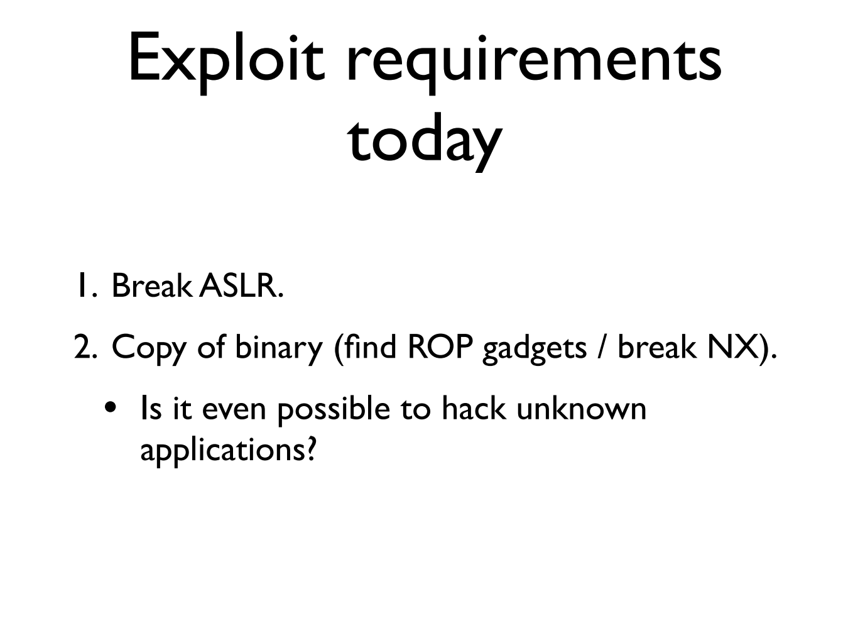

Slide 55
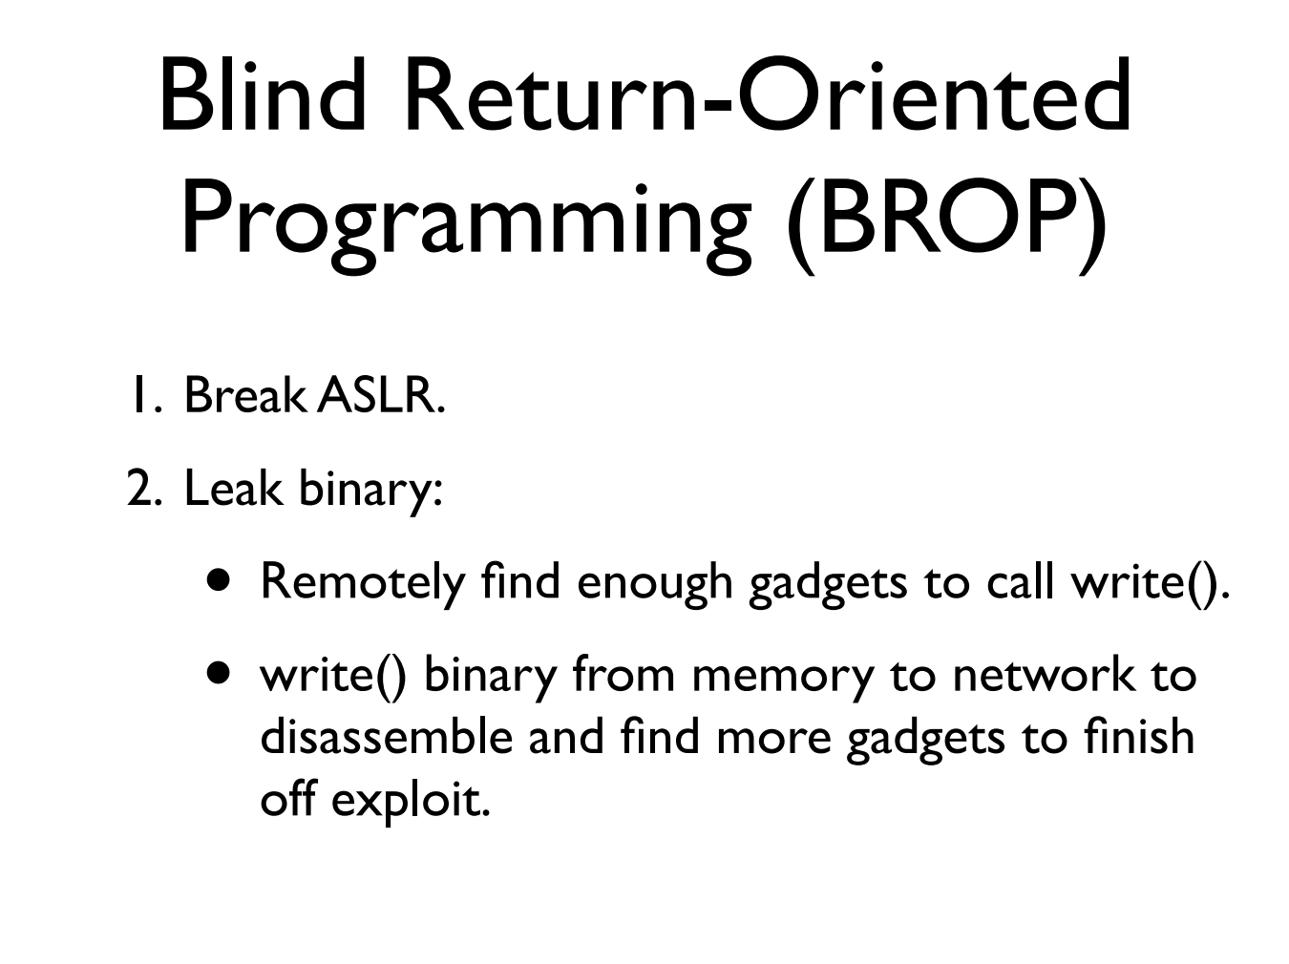

Slide 56
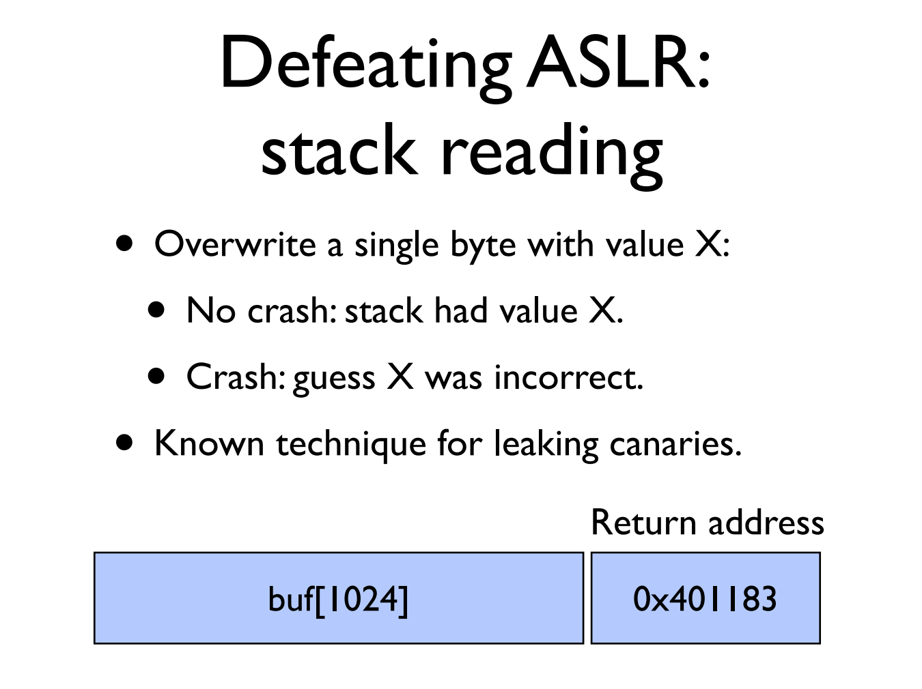

Slide 57
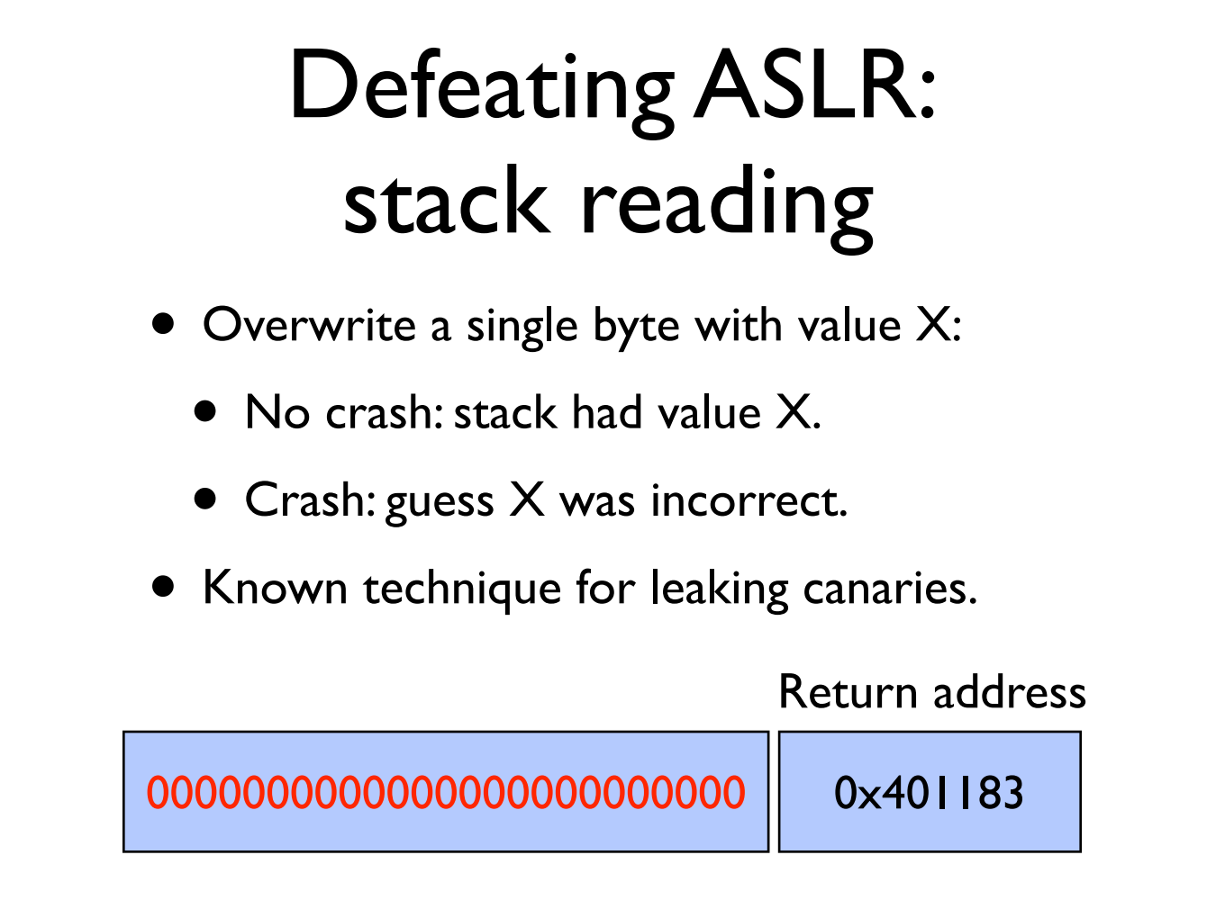

Slide 58
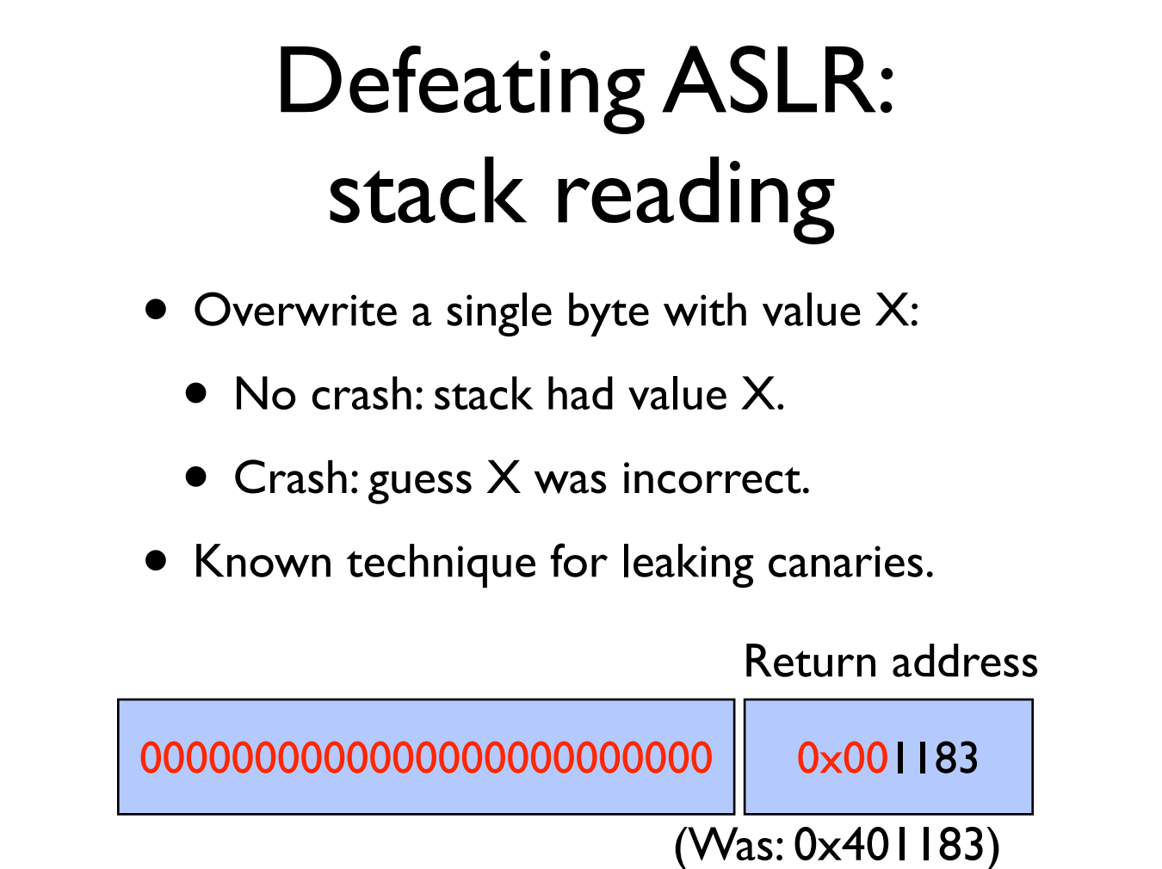

Slide 59


Slide 60


Slide 61
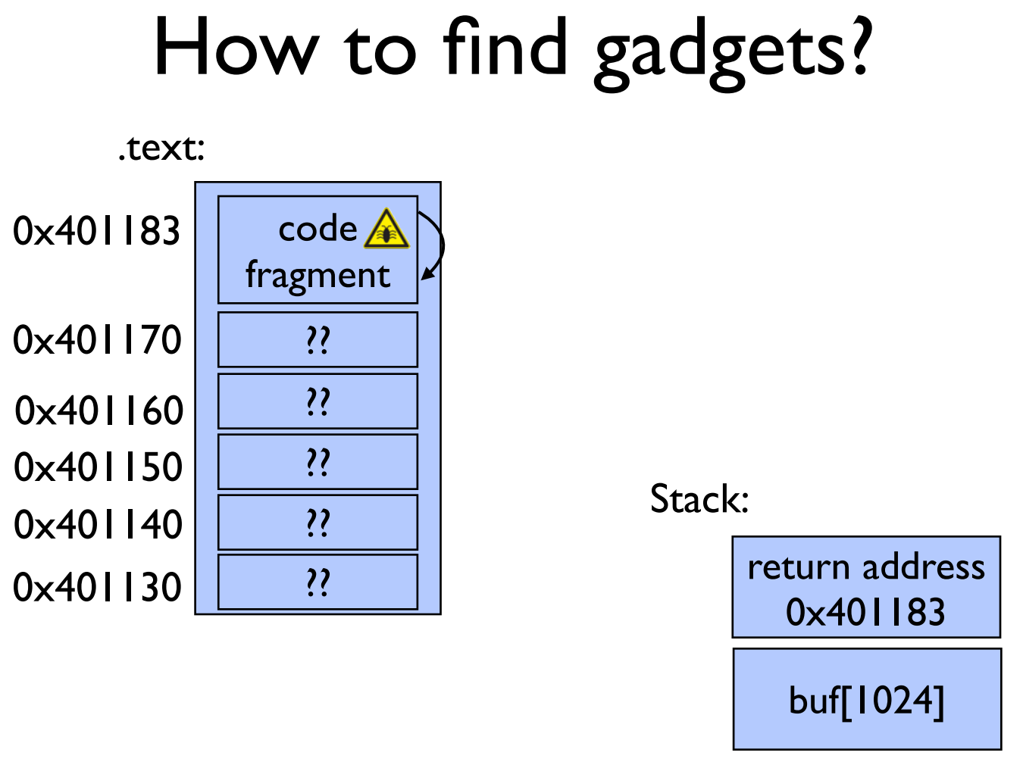

Slide 62
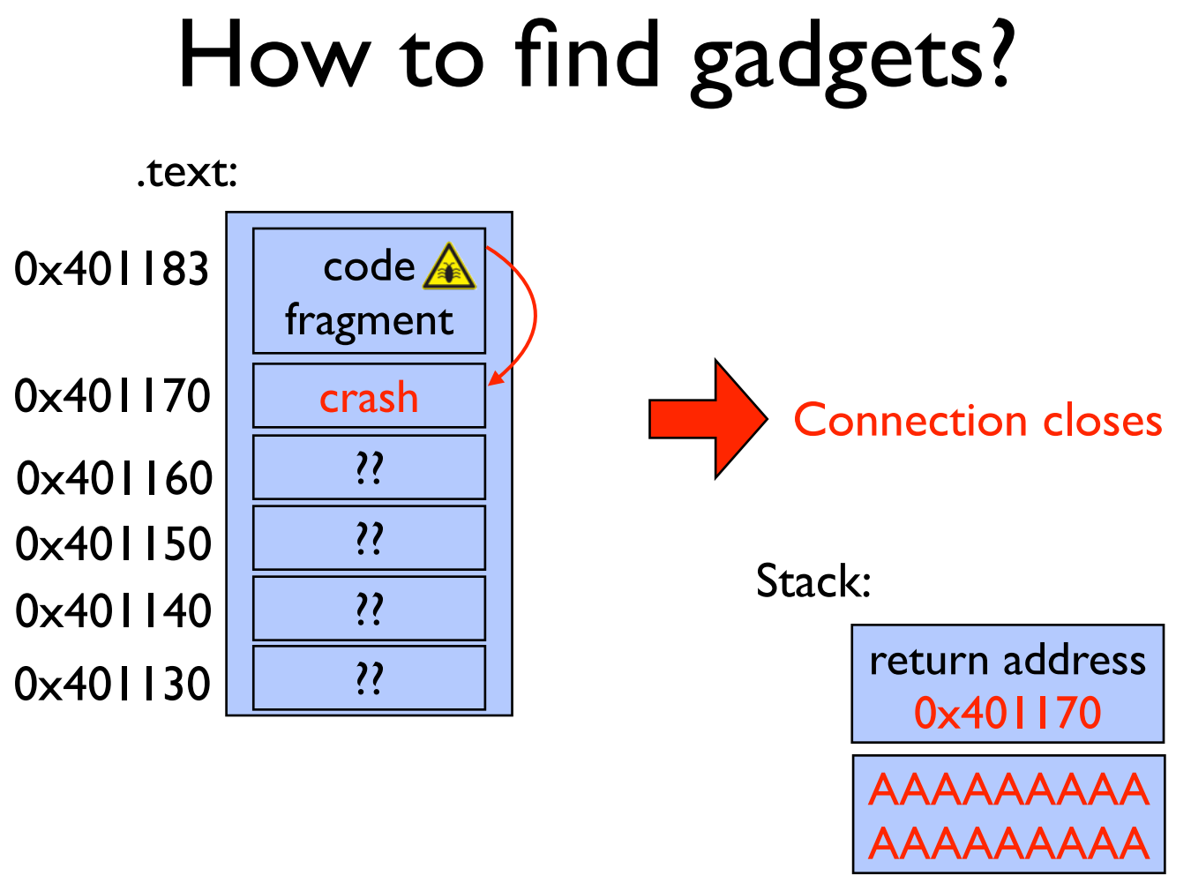

Slide 63


Slide 64
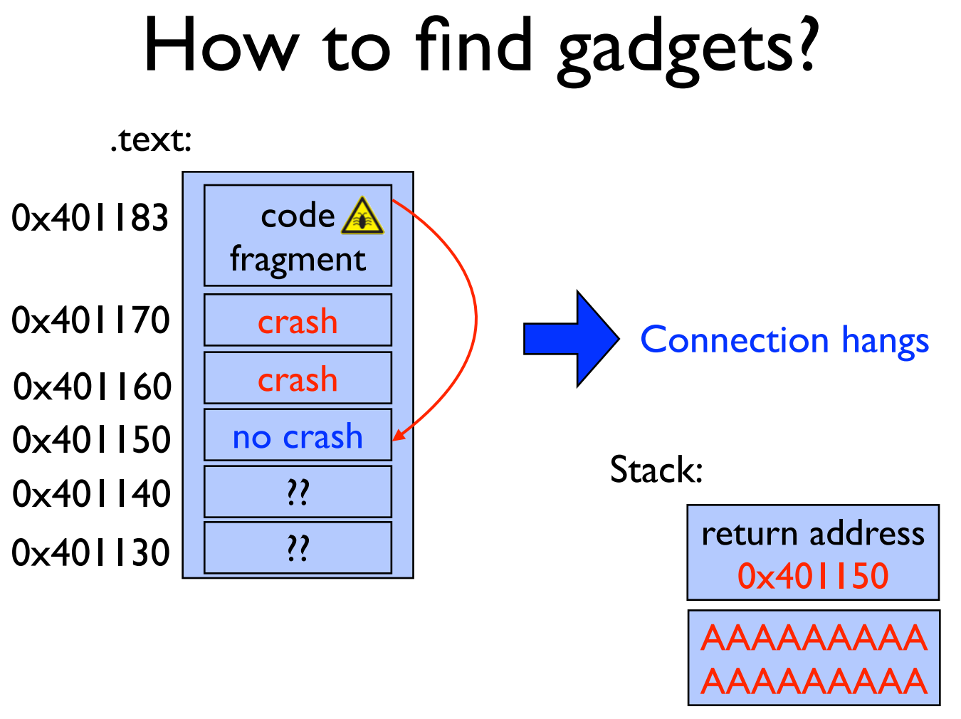

Slide 65
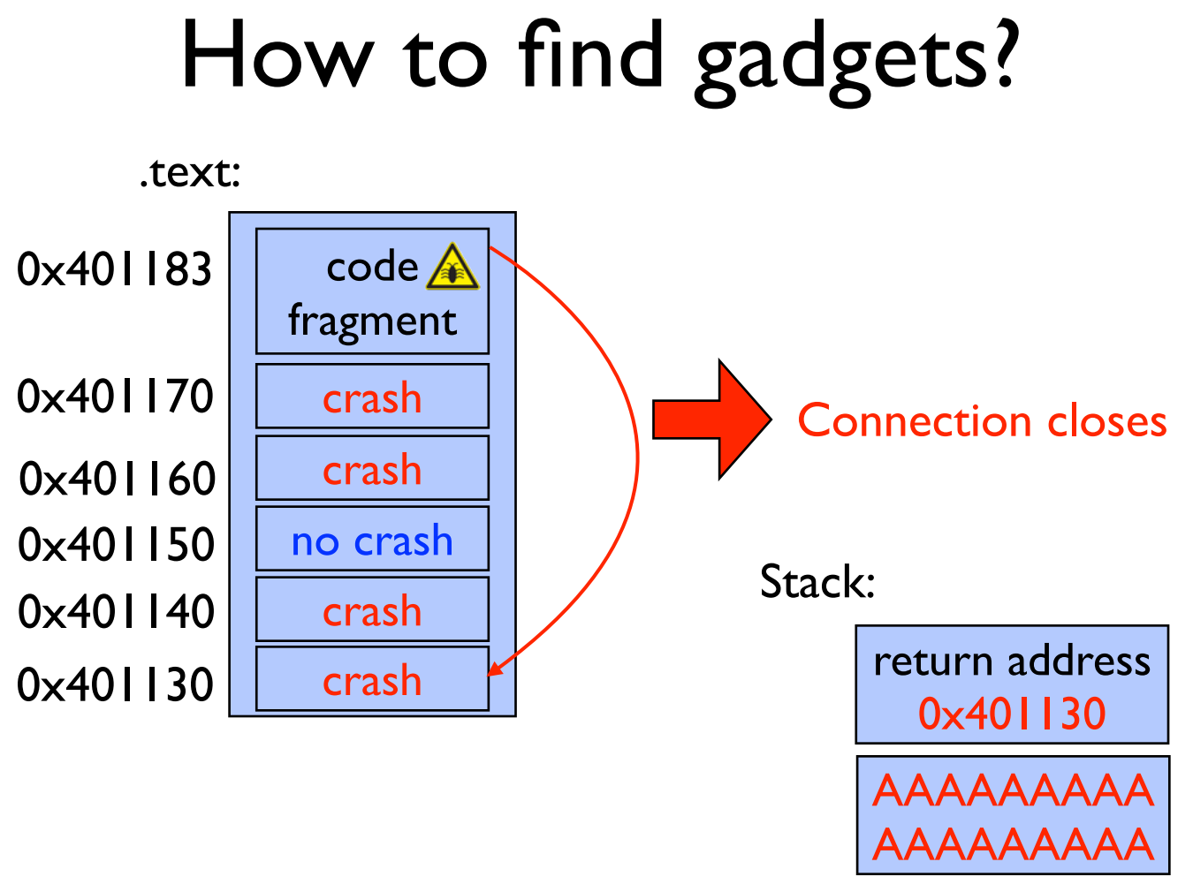

Slide 66
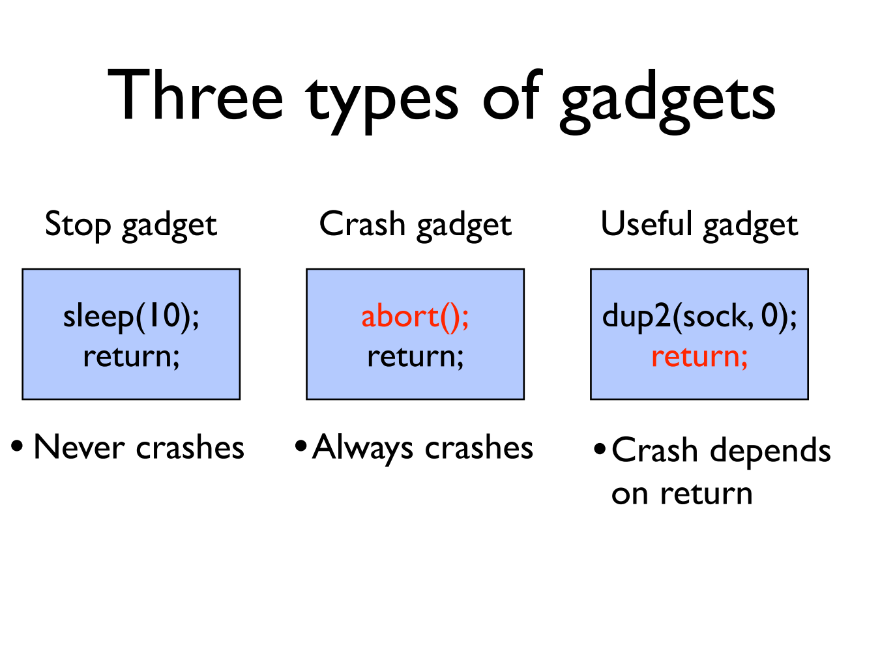

Slide 67
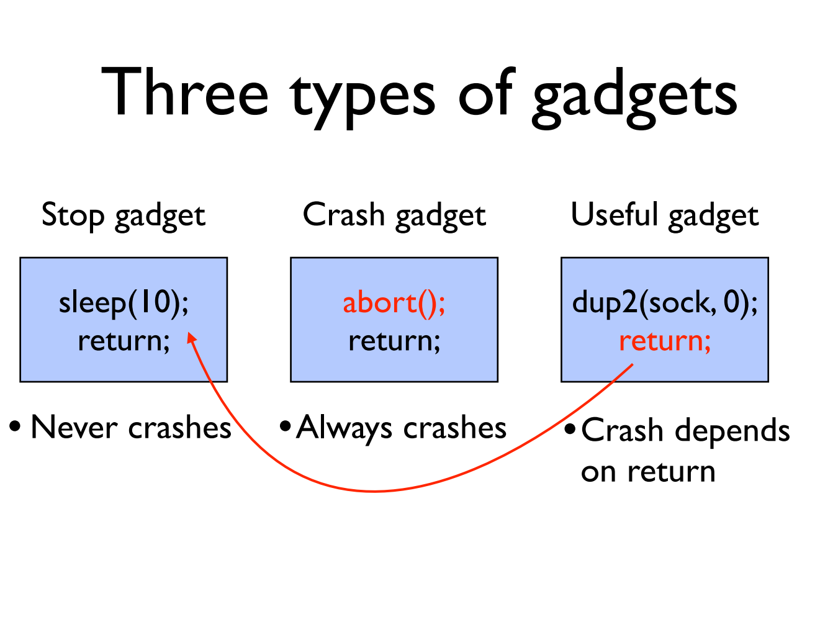

Slide 68
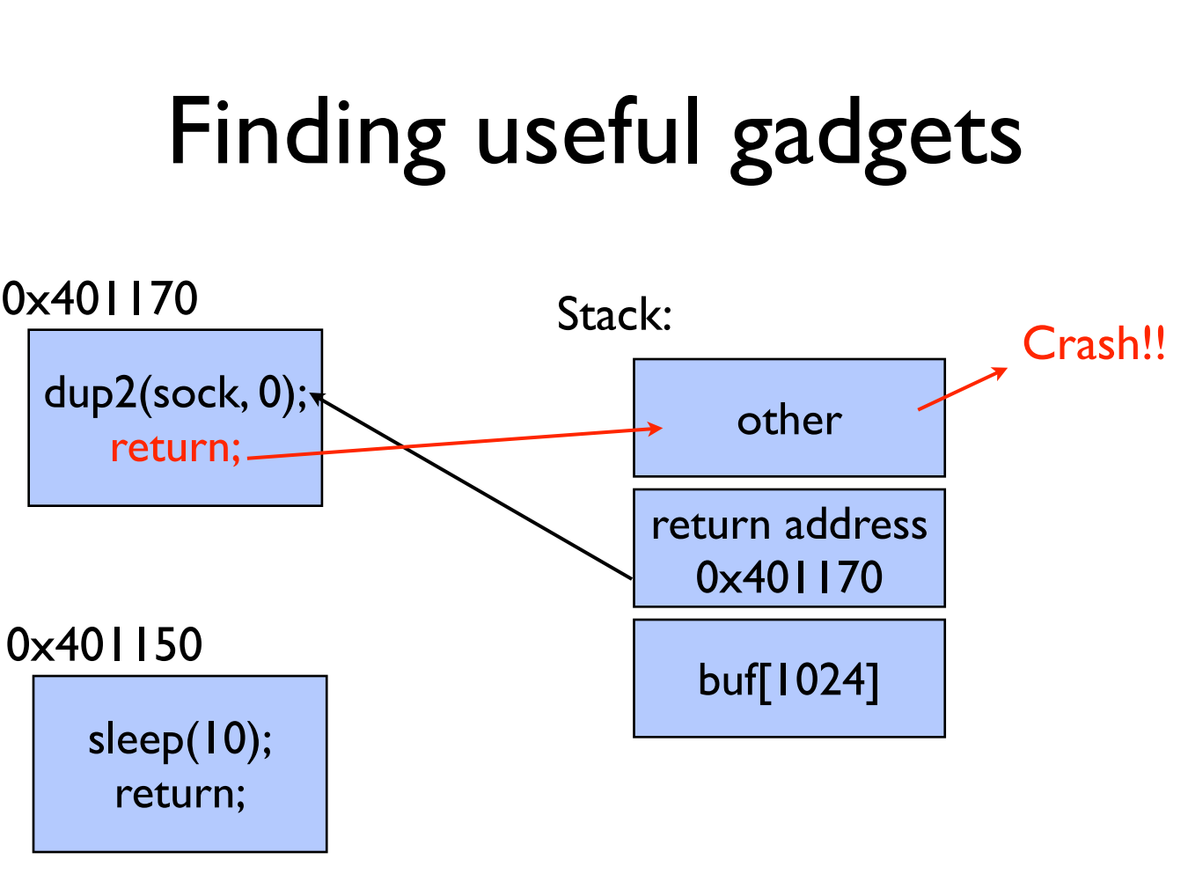

Slide 69
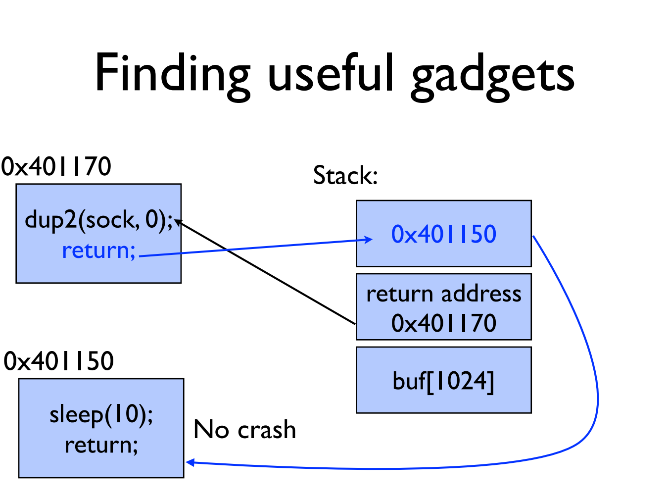

Slide 70
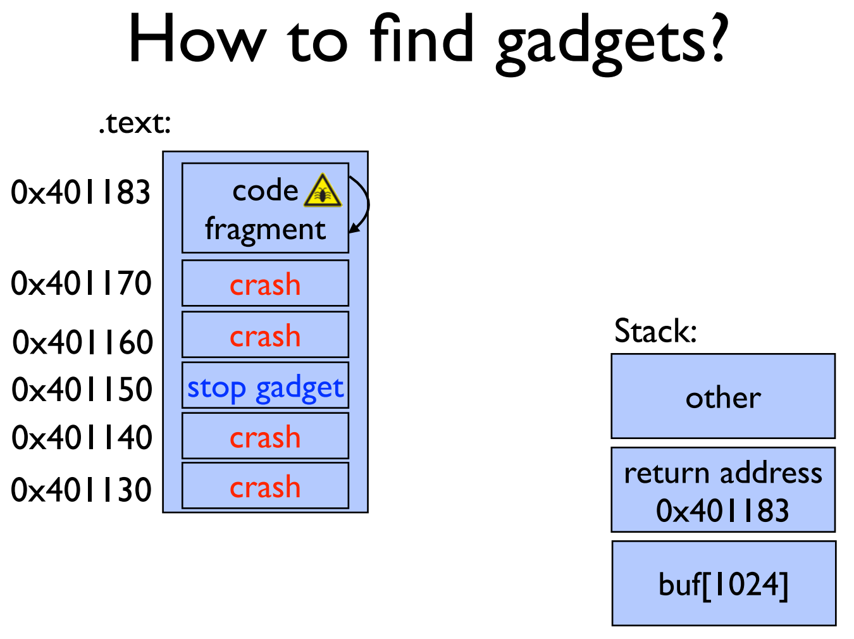

Slide 71
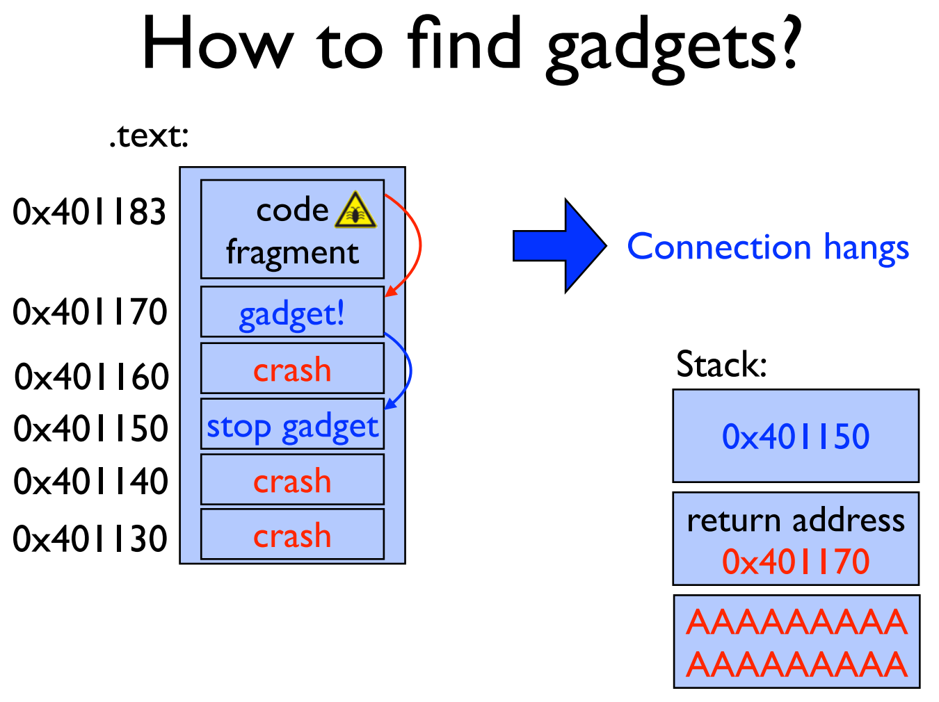

Slide 72
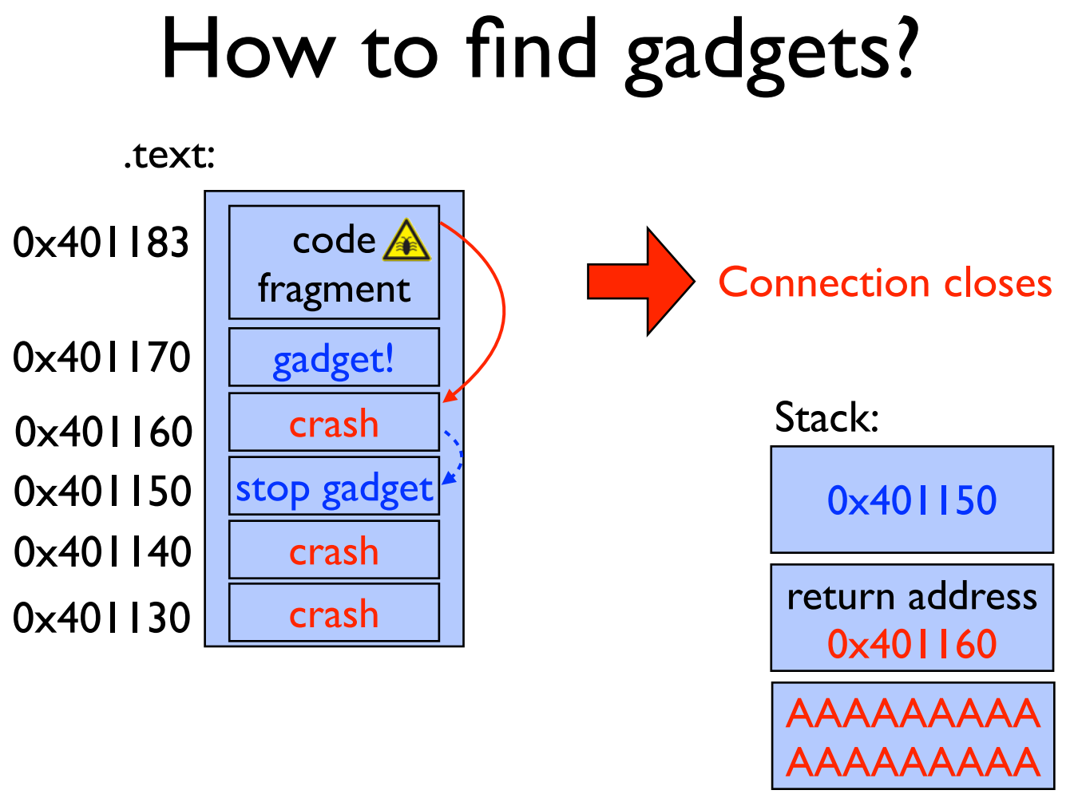

Slide 73
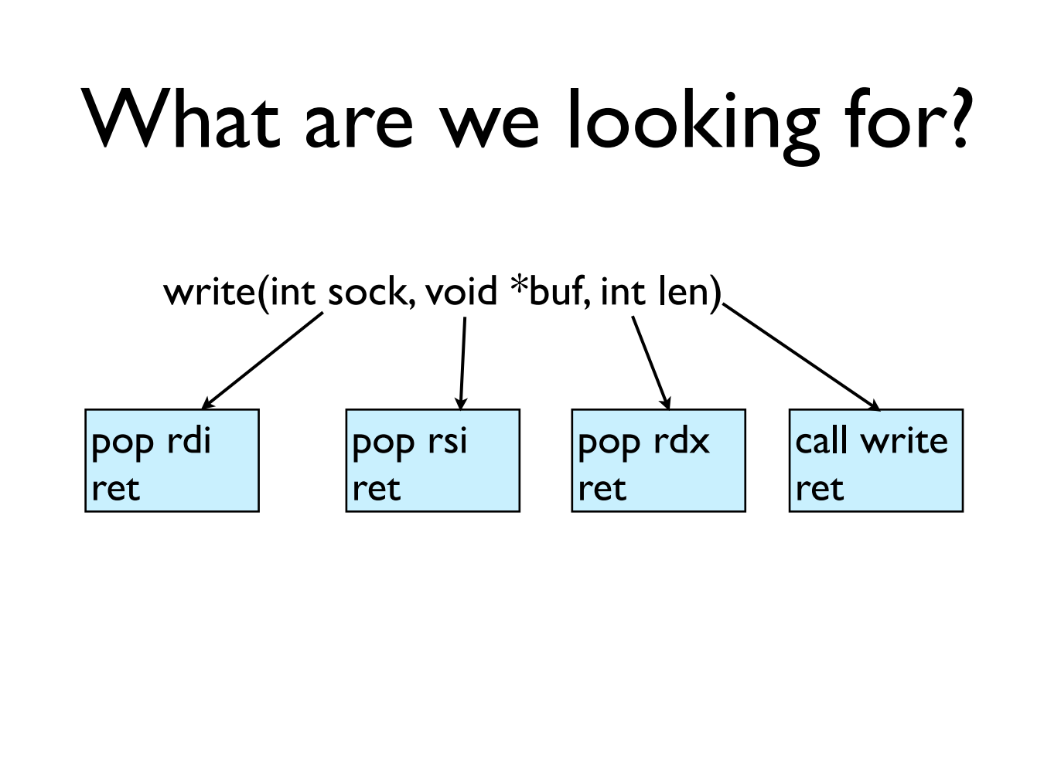

Slide 74
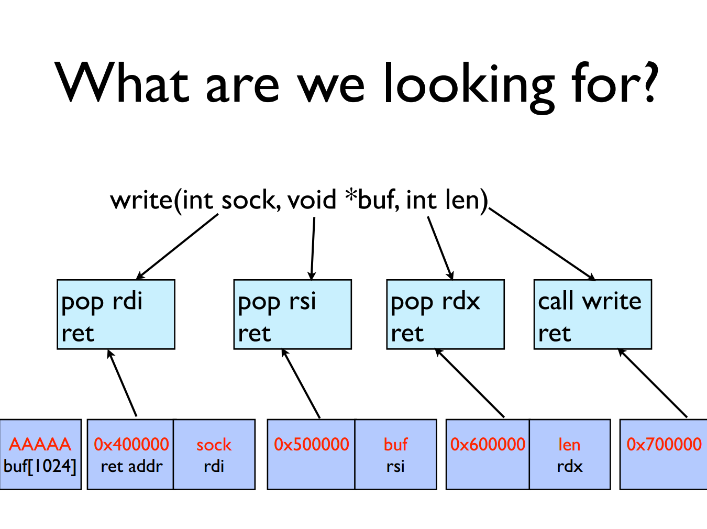

Slide 75
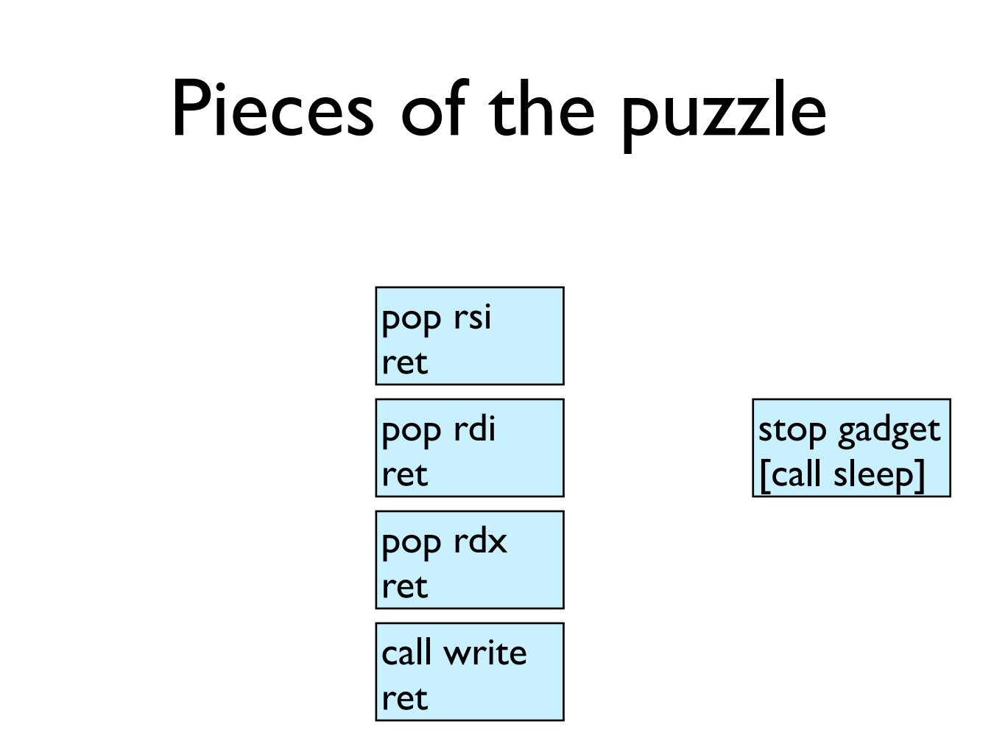

Slide 76
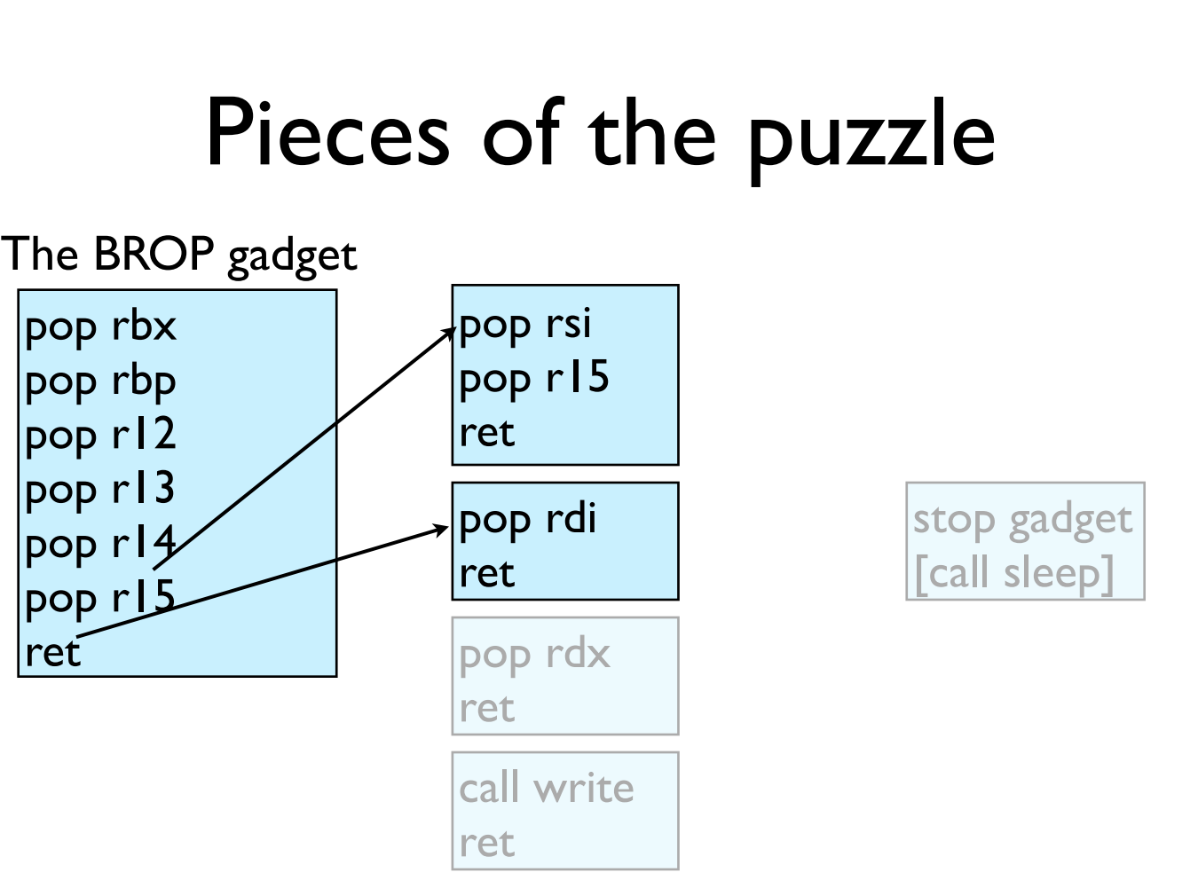

Slide 77
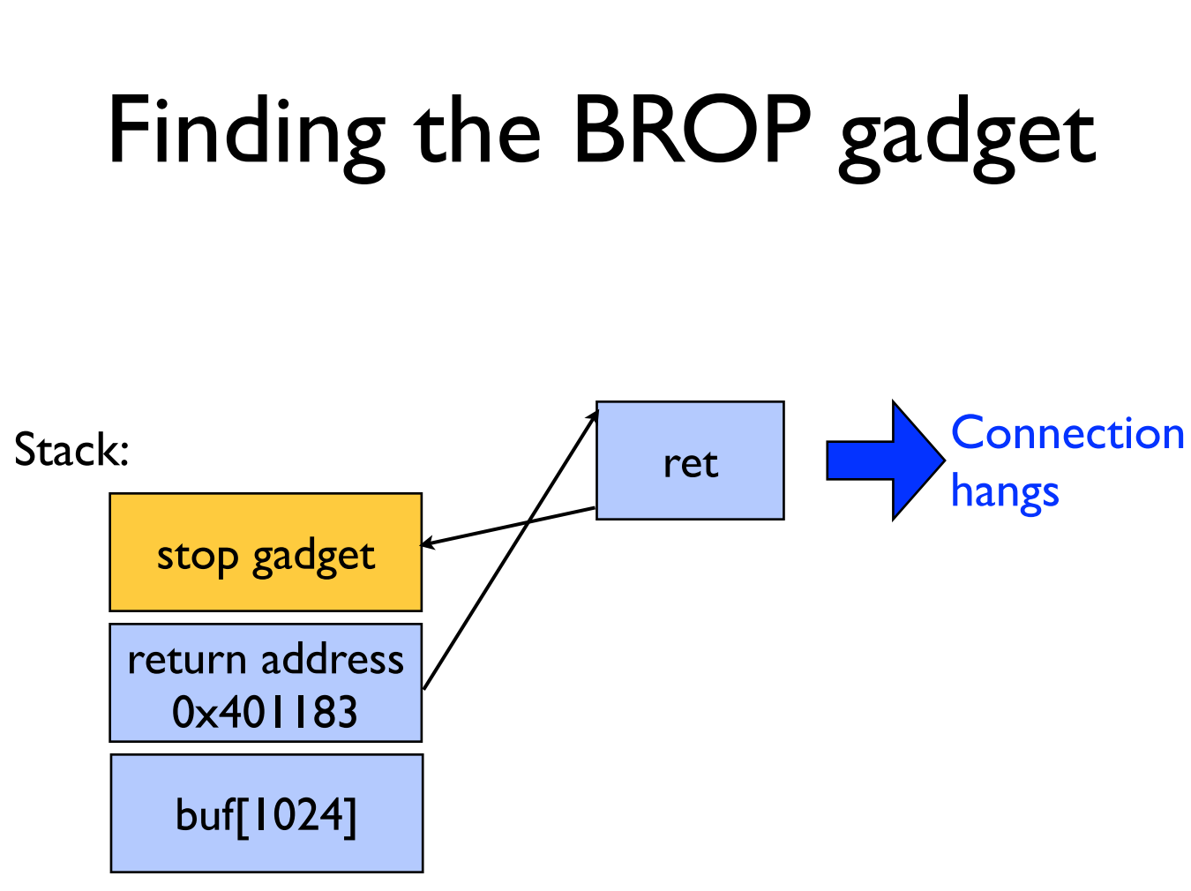

Slide 78
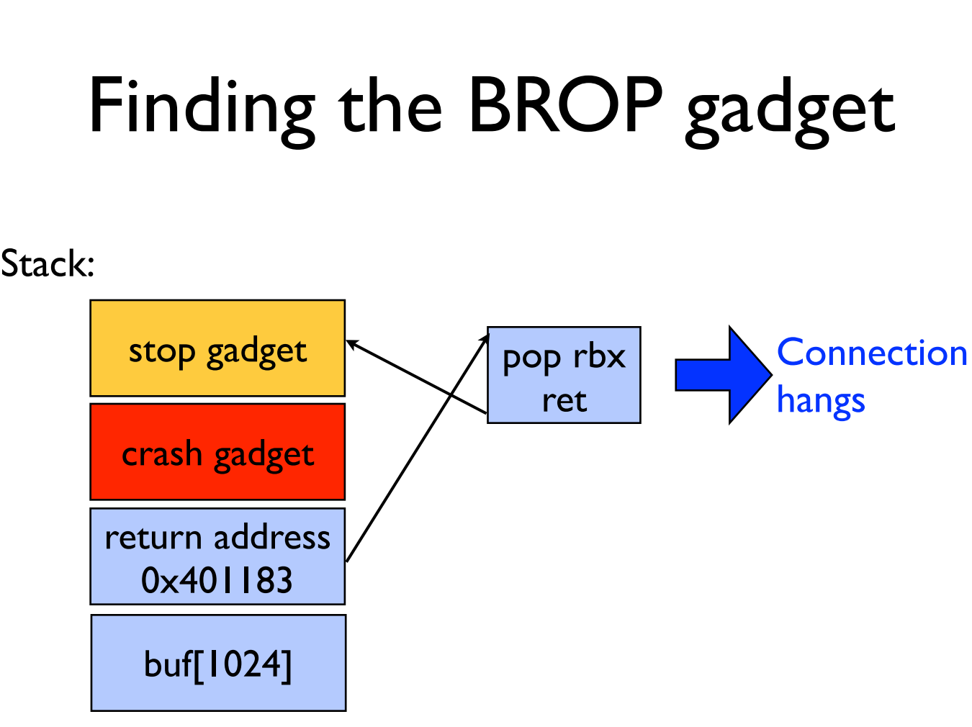

Slide 79
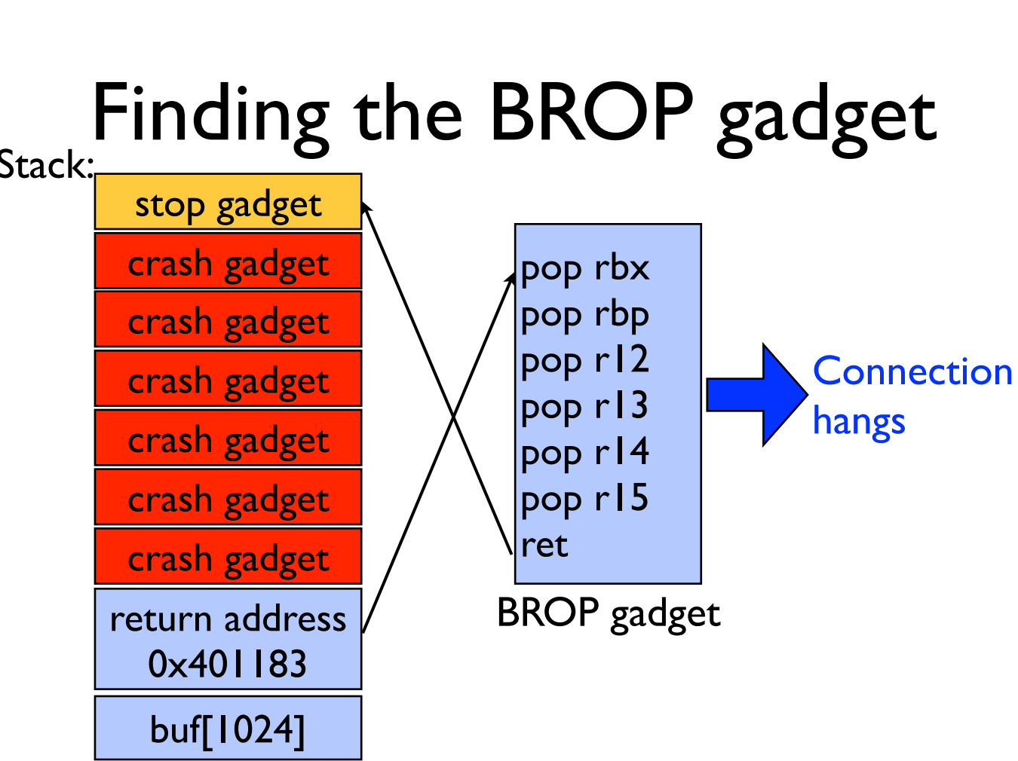

Slide 80
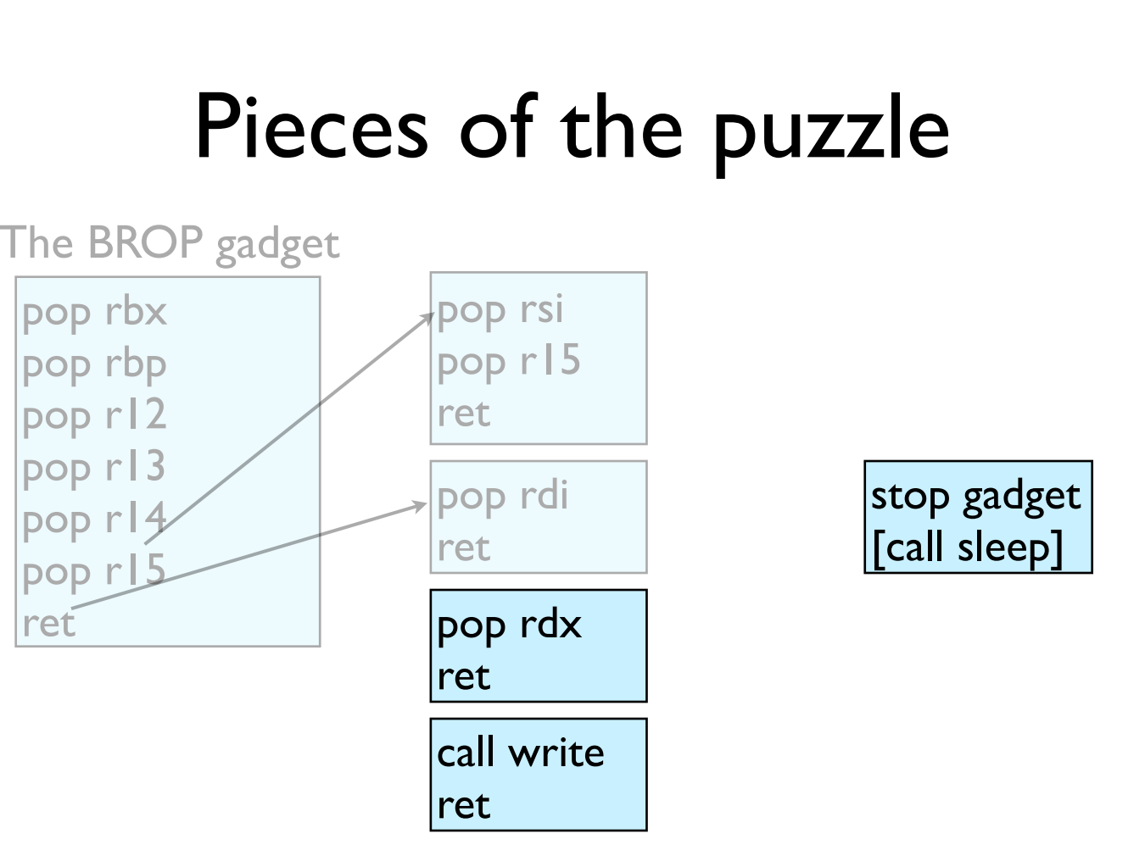

Slide 81
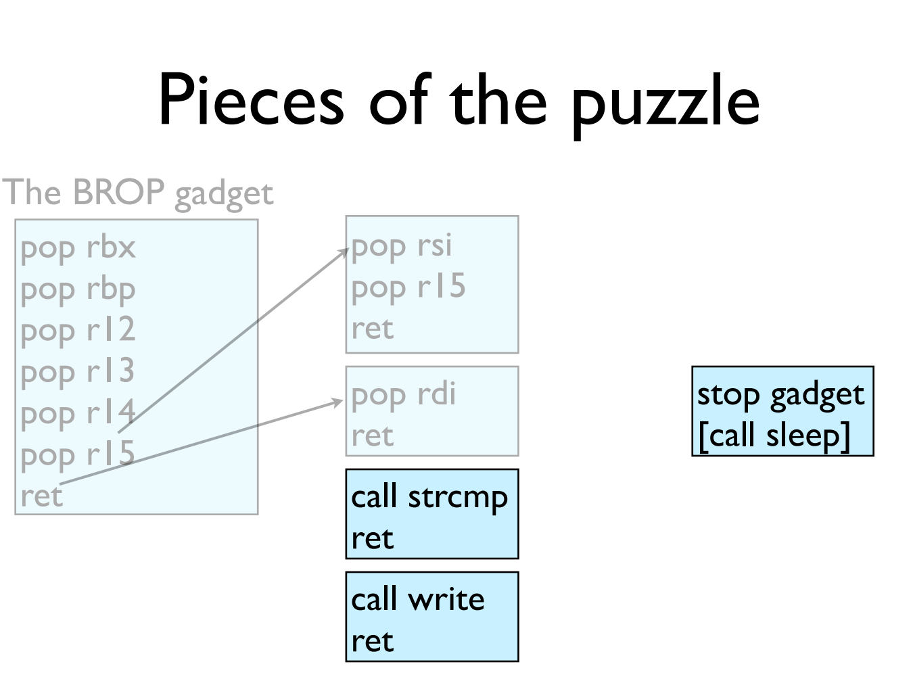

Slide 82
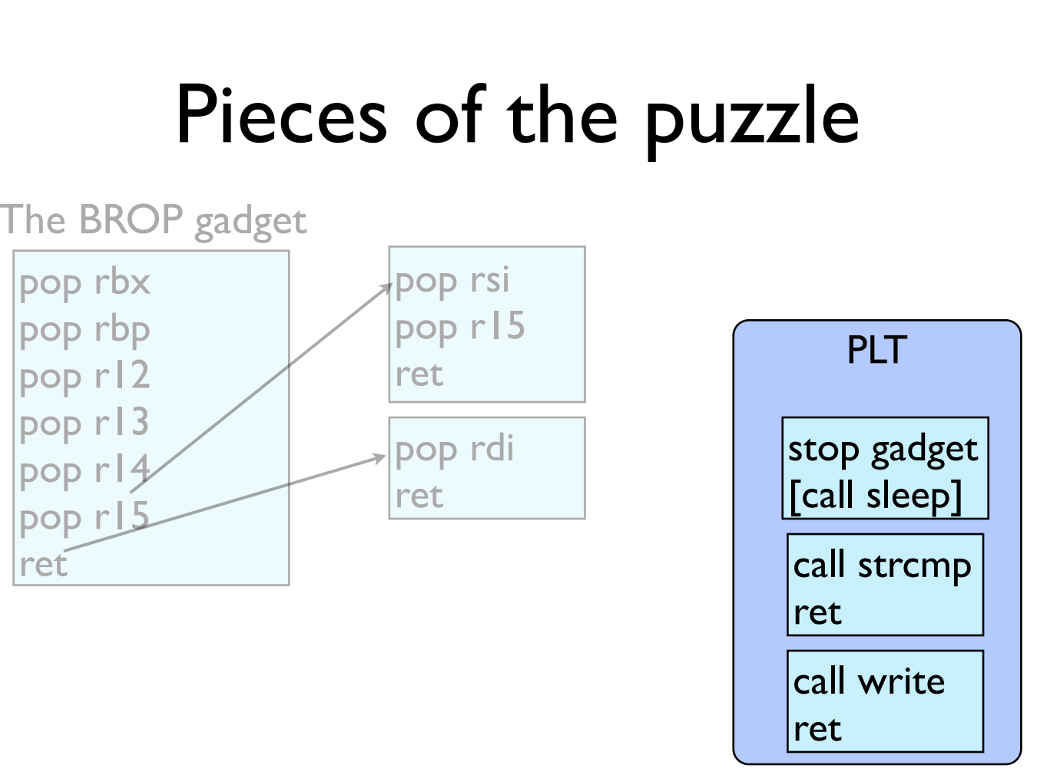

Slide 83
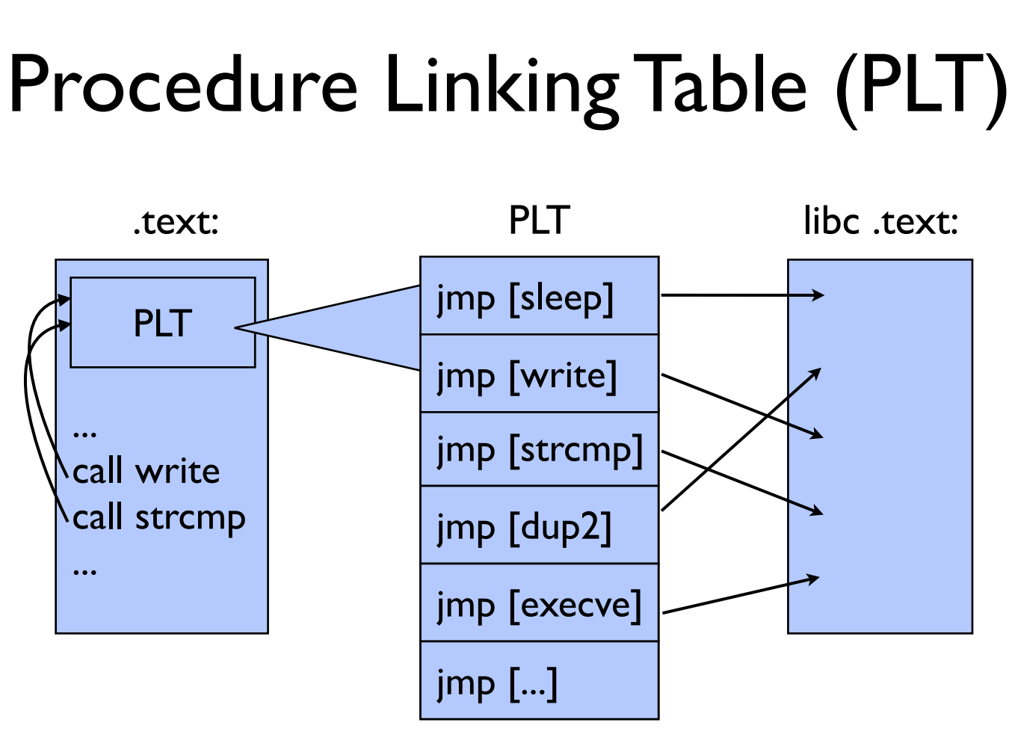

Slide 84
GOT & PLT
Jump to the address that this entry of the GOT contains:
  First time: call to dynamic linker and write the function address to GOT
  Not first time: the GOT already contains the address that points to printf.
PLT
printf() call
Dynamic linker
libc
GOT

Slide 85

Notes:
另外，大部分的PLT项都不会因为传进来的参数的原因crash，因为它们很多都是系统调用，都会对参数进行检查，如果有错误会返回EFAULT而已，并不会造成进程crash。所以攻击者可以通过下面这个方法找到PLT：如果攻击者发现好多条连续的16个字节对齐的地址都不会造成进程crash，而且这些地址加6得到的地址也不会造成进程crash，那么很有可能这就是某个PLT对应的项了。

Slide 86


Slide 87

Notes:
1. 同时调用好几次write，把它们串起来，然后传入不同的文件描述符数；2. 同时打开多个连接，然后使用一个相对较大的文件描述符数字，增加匹配的可能性。

Slide 88


Slide 89


Slide 90


Slide 91


Slide 92
Try It!
http://www.scs.stanford.edu/brop/
More information
  S&P'14 paper: http://www.scs.stanford.edu/brop/bittau-brop.pdf
  Blog: http://drops.wooyun.org/tips/3071

